Slide 1
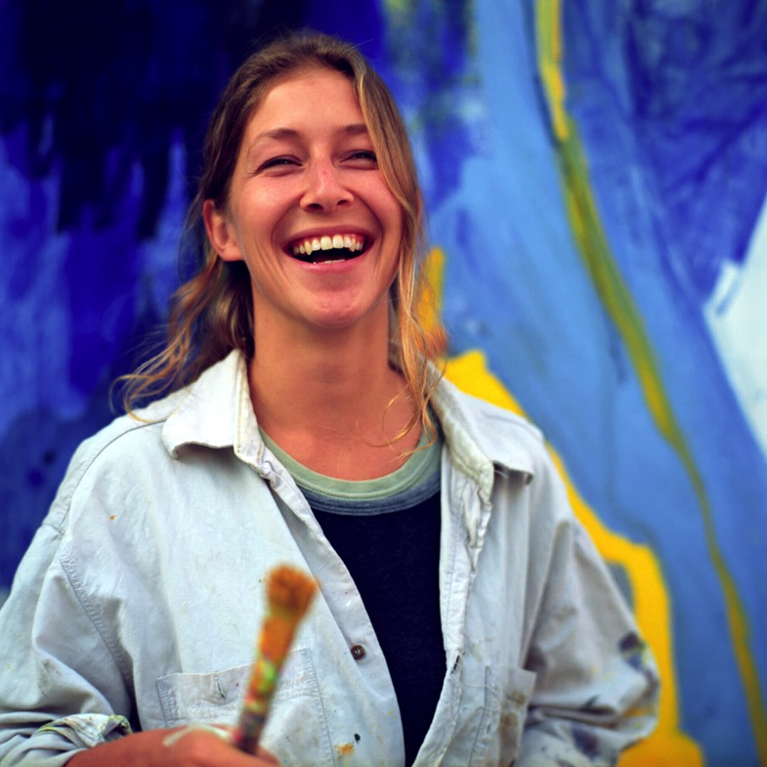
Creative Chromatography Background Information
^{BP Schools Link}

Slide 2
Looking for Chemicals which are hidden
In some products the chemicals we want to measure can be hidden / masked by other bigger molecules
We need to use separate these first before we can measure these
Using GCMS – Gas Chromatography Mass Spectroscopy which separates the different chemicals first followed by detailed chemical analysis.
We can check the levels of the Antioxidants over the course of their use
BP Schools Link – Creative Chromatography
8

Slide 3
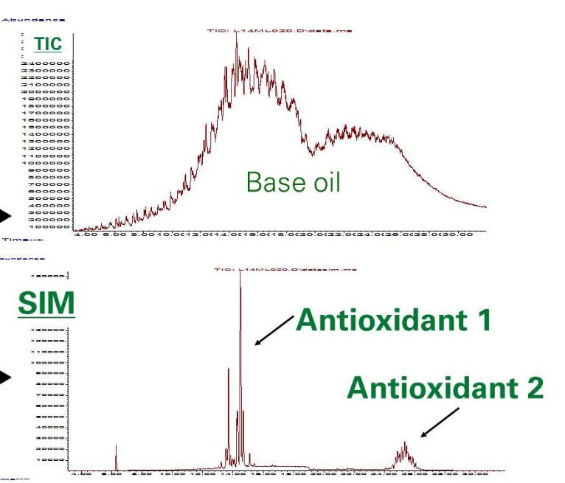
Looking for Chemicals which are hidden
BP Schools Link – Creative Chromatography
8

Slide 4
Looking for impurities in jet fuel
Jet Fuel quality is of great importance and is closely scrutinised
There is a limit for the amount of impurities allowed and a method to measure these impurities
Using GCMS – Gas Chromatography Mass Spectroscopy which separates the different chemicals first followed by detailed chemical analysis.
BP Schools Link – Creative Chromatography
8

Slide 5
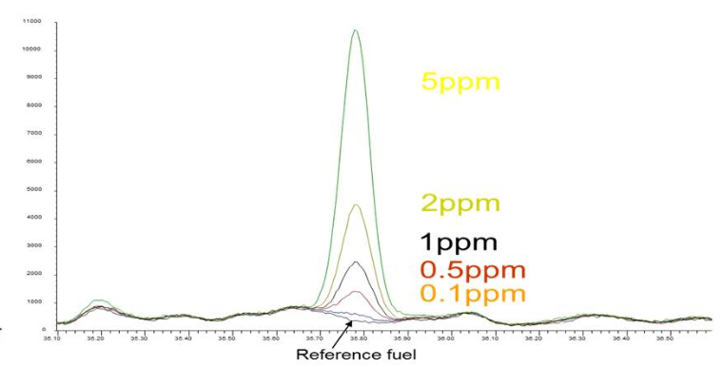
Looking for impurities in jet fuel
5ppm
2ppm
1ppm
0.5ppm
0.1ppm
BP Schools Link – Creative Chromatography
8

Slide 6
Chromatography also helps us to…
Test water samples for pollution
Test air samples for pollution, explosives or drugs
Identify people, using a sample from their body
Detect pesticides in food
BP Schools Link – Creative Chromatography
14

