Slide 1

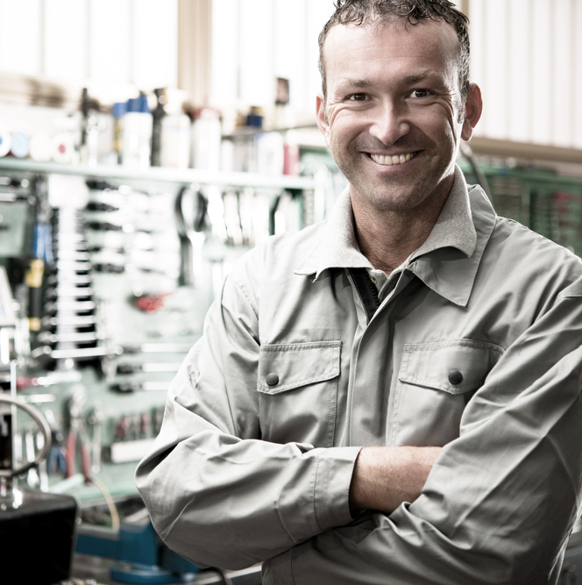
^{Creative Chromatography}
^{BP Schools Link}

Slide 2
^{Today we’re going to:}
Recall what we know about mixtures
Think of ways to separate mixtures
Find out about one method - chromatography
Create a fair test
Become ‘lab detectives’ and solve a problem
BP Schools Link – Creative Chromatography
2

Slide 3
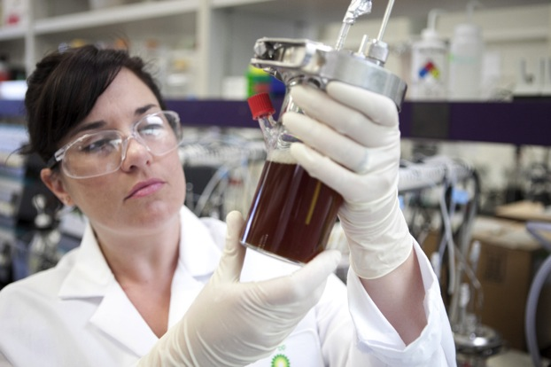
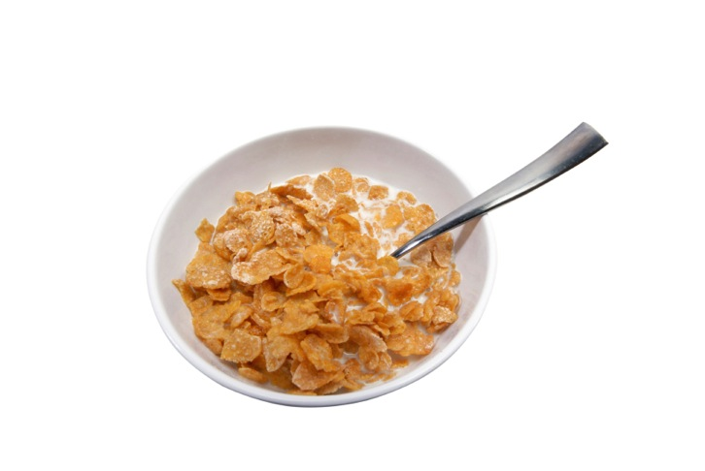
^{All mixed up}
Mixtures are all around us:
The crude oil that BP turns into fuels
Our favorite foods and drinks
BP Schools Link – Creative Chromatography
3

Slide 4
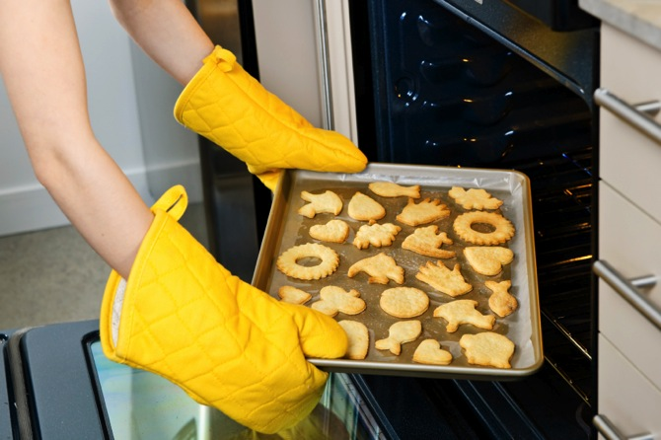
^{Can we un-mix} ^{it?}
What about:
Sand and water?
A bag of sweets?
Sugar and rice?
Sugar and water?
The flour, sugar, egg and butter in baked biscuits?
BP Schools Link – Creative Chromatography
4

Slide 5
^{What is chromatography?}
Start
Paper slip
Ink spot
Water level
BP Schools Link – Creative Chromatography
5

Slide 6
^{What is chromatography?}
Start
Intermediate
Paper slip
Water level
Ink spot
Water level
BP Schools Link – Creative Chromatography
6

Slide 7
^{What is chromatography?}
Start
Intermediate
Finish
Water level
Paper slip
Water level
Ink spot
Water level
BP Schools Link – Creative Chromatography
7

Slide 8

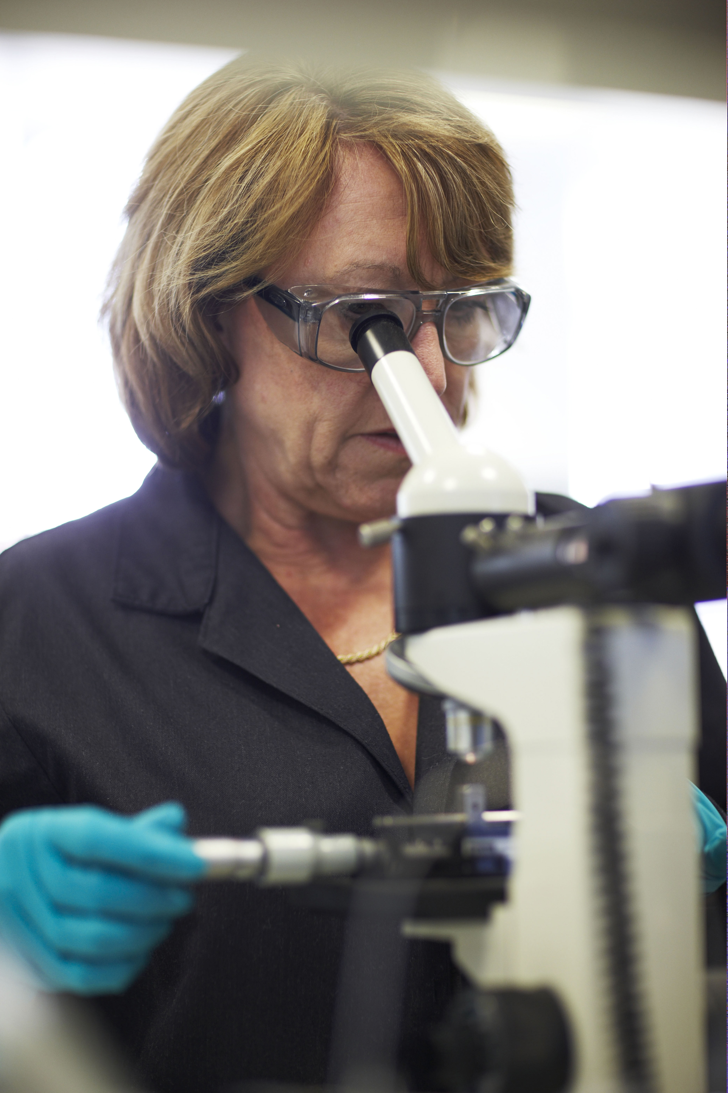
^{Where do we use Chromatography}
To test customer samples
after a problem
To enable us to analyze
different types of Chemistry
To look at the quality of
our products
BP Schools Link – Creative Chromatography
8

Slide 9
Looking at oils in a broken down car
Using Gas Chromatography we can identify different types of chemistry based on their size
This technique also allows us to view any chemicals which should not be present.
This type of analysis is know as fingerprint analysis
BP Schools Link – Creative Chromatography
9

Slide 10
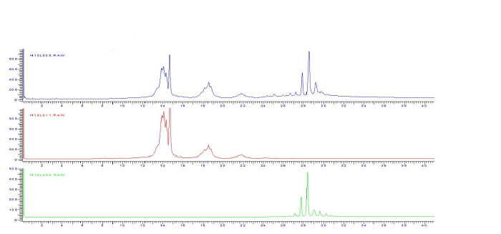
Looking at oils in a broken down car
Oil from Car
Fresh Castrol Oil
Groundnut Vegetable Oil
BP Schools Link – Creative Chromatography
10

Slide 11
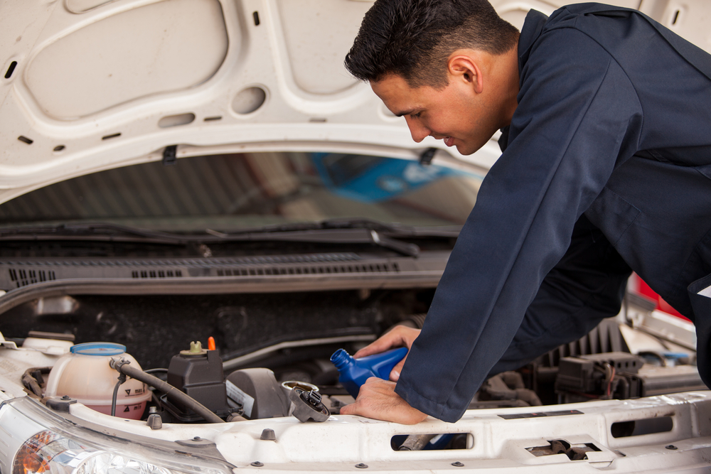
^{A car engine is broken!}
BP Schools Link – Creative Chromatography
11

Slide 12
^{This is what we know}
A lady driver owns a performance car
She says she changed the engine using BP oil and now it won’t work
She blames BP and wants a new car!
Her husband can’t offer any other explanations.
BP Schools Link – Creative Chromatography
12
Notes:
You can change the names to the names of BP volunteers if you wish and even add photos.

Slide 13
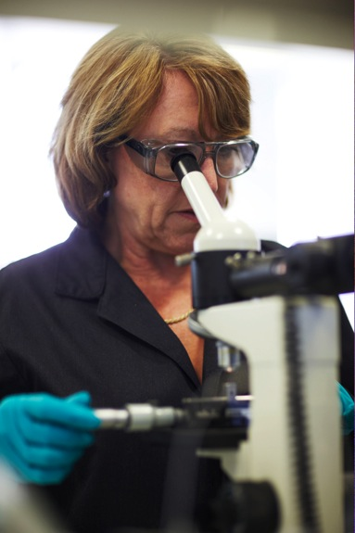
^{Test your evidence!}
Read your lab notes
Think how to make your test fair
Write down your ideas
BP Schools Link – Creative Chromatography
13

Slide 14
^{Primary} ^{colours}
Purple
BLUE
Green
RED
YELLOW
Orange
BP Schools Link – Creative Chromatography
14

Slide 15
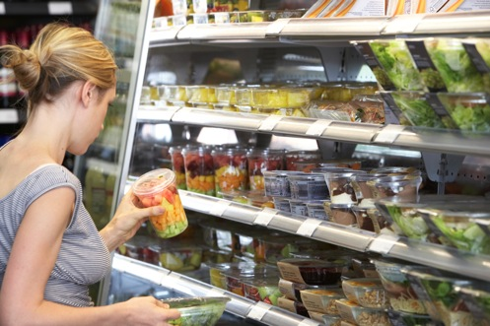
^{Chromatography helps us to…}
Test water samples for pollution
Test for additives in fuels and oils
Test air samples for pollution, explosives or drugs
Identify people, using a sample from their body
Detect pesticides in food
BP Schools Link – Creative Chromatography
15

