Slide 1
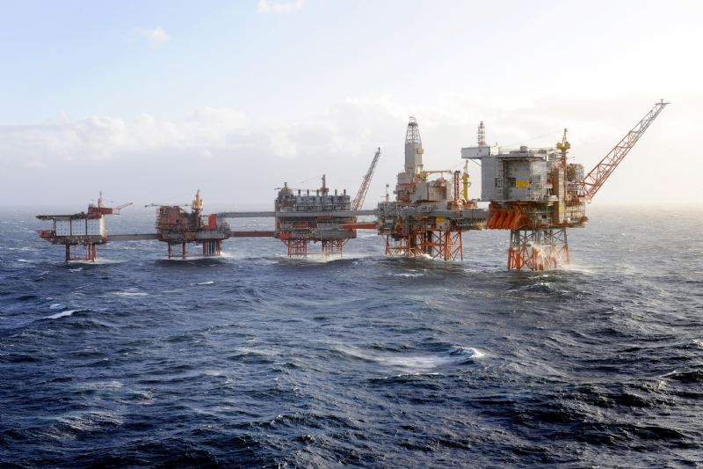
^{Ex’straw’dinary Engineering}
BP Schools Link: Introductory presentation

Slide 2
^{Today’s objectives}
Explore the work of engineers
Think about what would make a good support structure for an oil rig
Work as a team to respond to a design brief
Reflect on how we worked together
BP Schools Link – Ex’straw’dinary Engineering
2

Slide 3
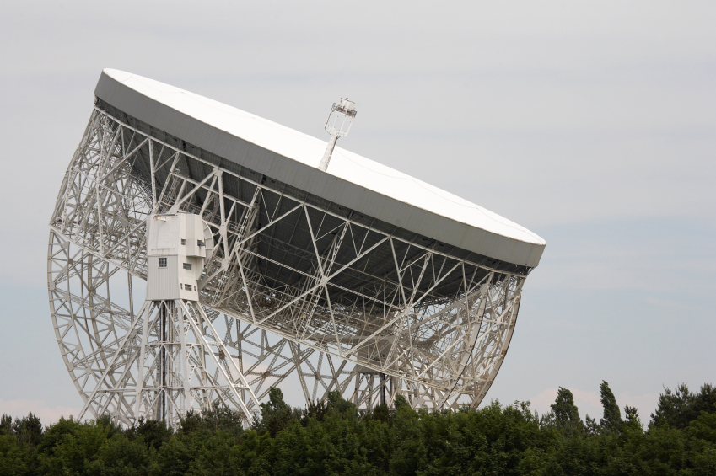
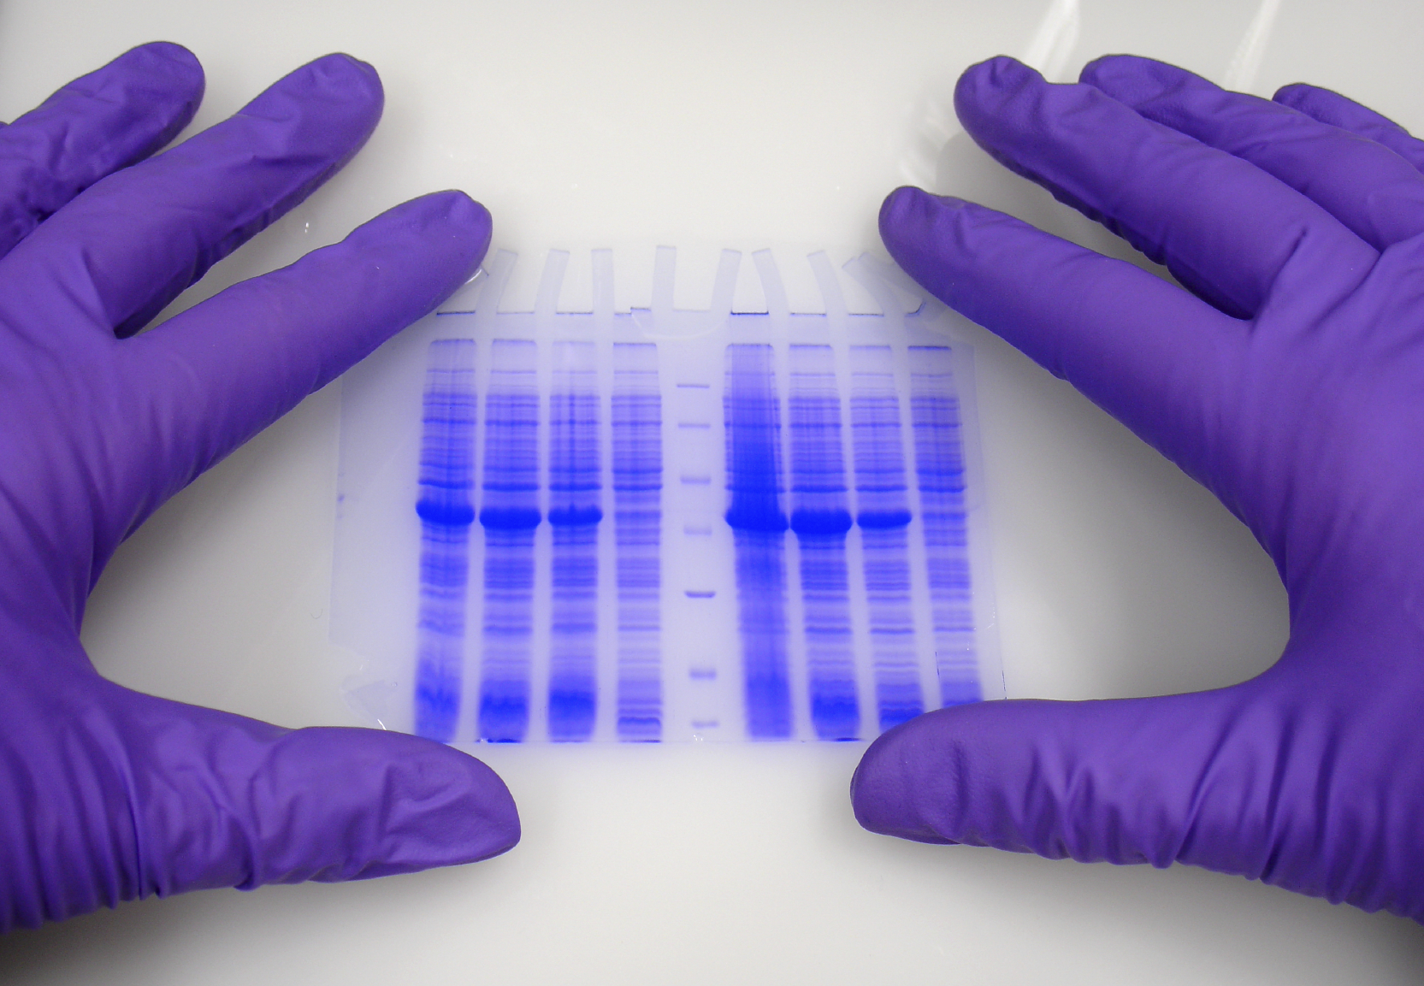
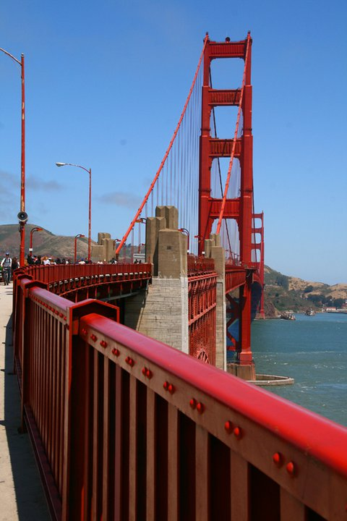
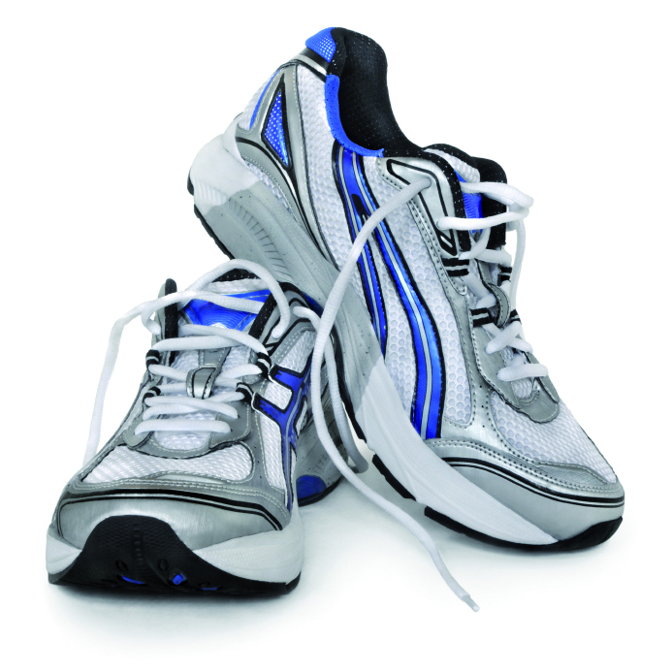
^{Engineering everywhere}
BP Schools Link – Ex’straw’dinary Engineering
3

Slide 4
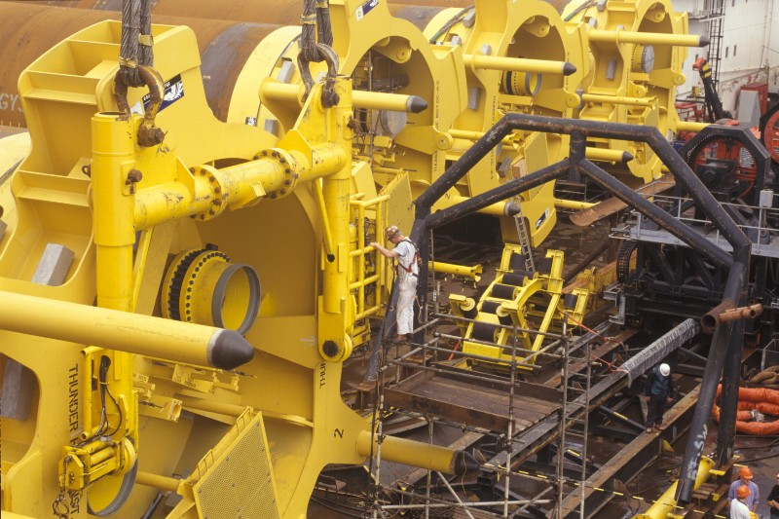
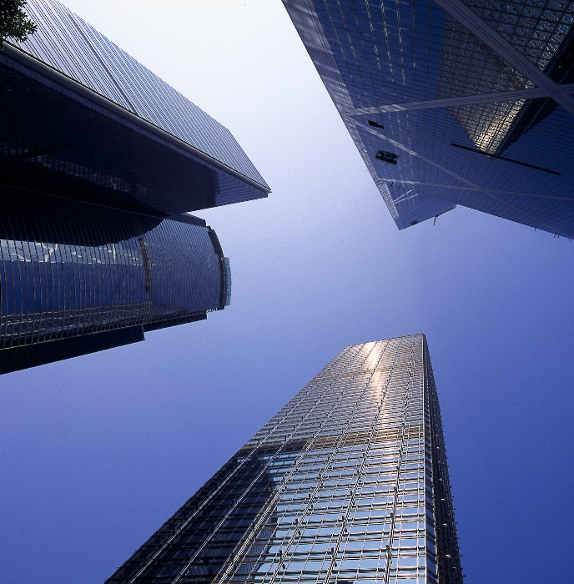
^{Types of engineer}
Civil and mechanical
BP Schools Link – Ex’straw’dinary Engineering
4

Slide 5
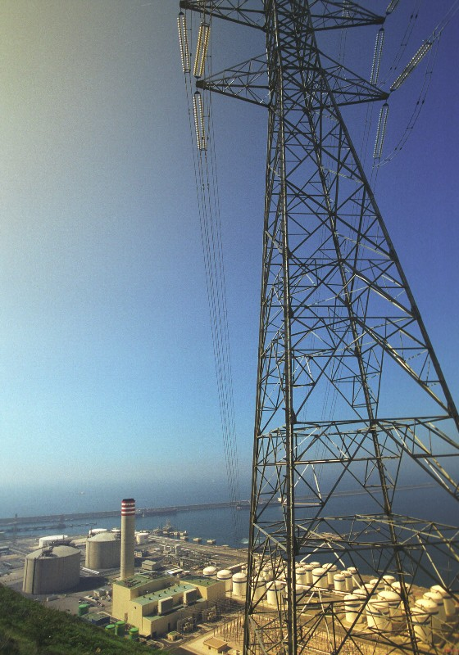
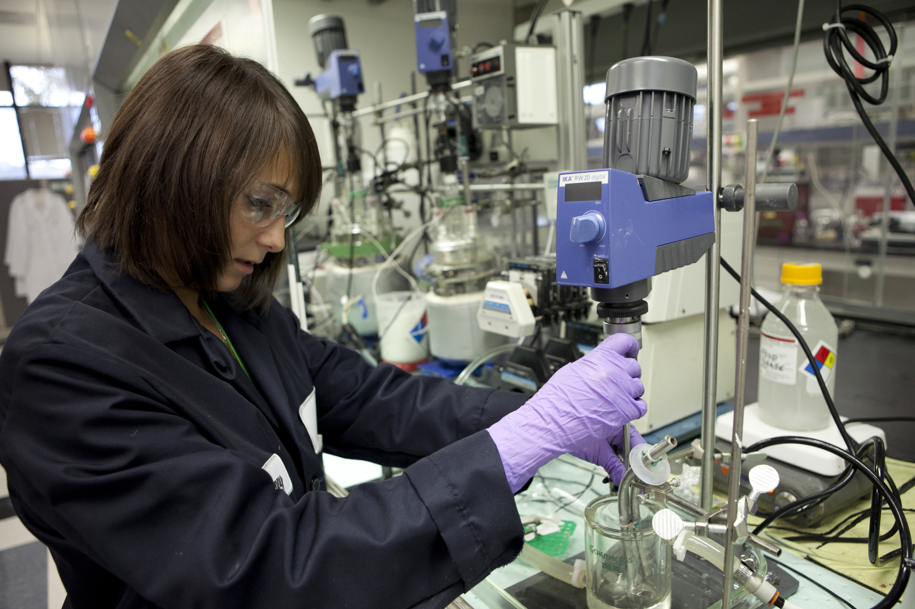
^{Types of engineer}
Chemical and electrical
BP Schools Link – Ex’straw’dinary Engineering
5

Slide 6
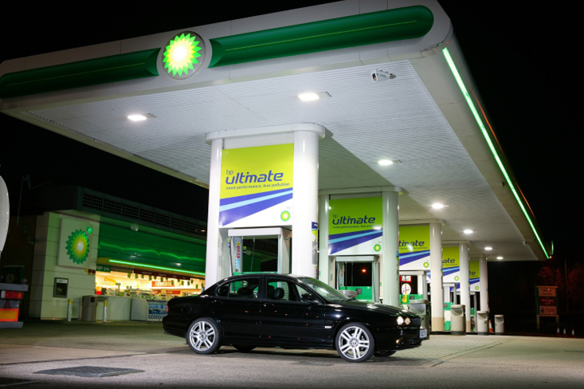
^{What do engineers do at BP?}
BP isn’t just about getting gasoline to your local garage
BP Schools Link – Ex’straw’dinary Engineering
6

Slide 7
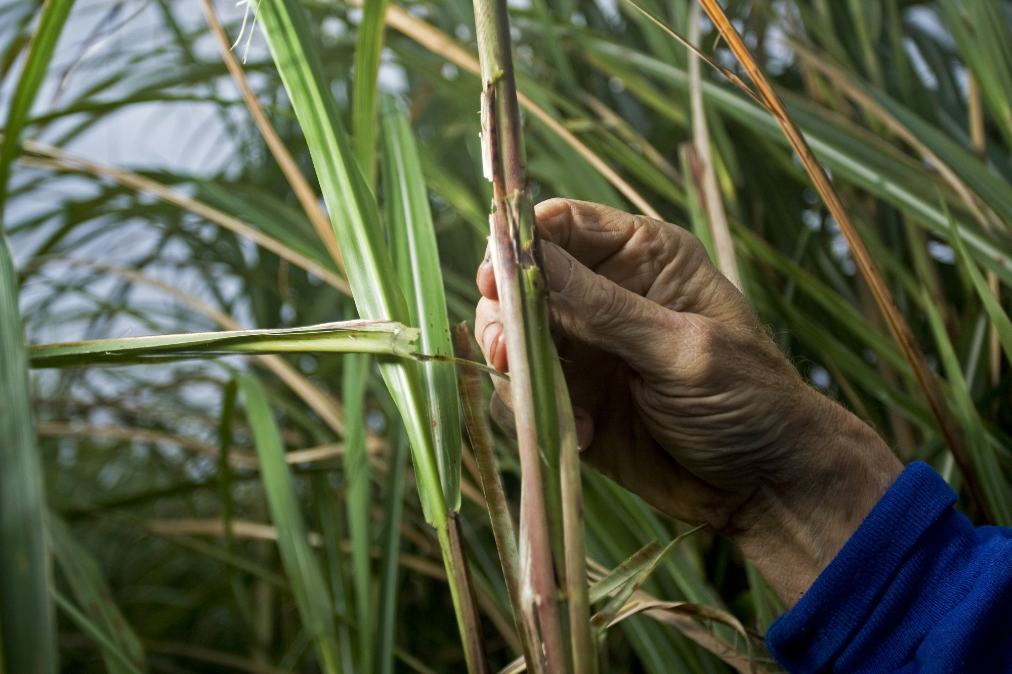
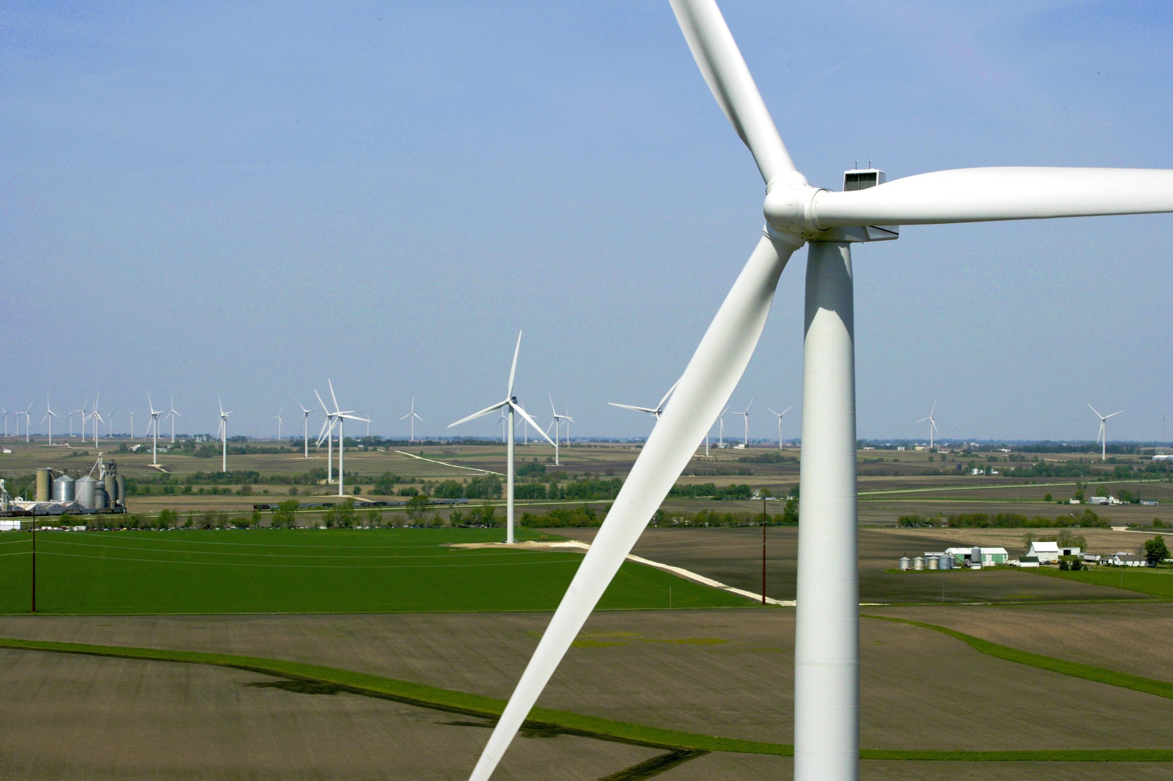
^{What do engineers do at BP?}
Engineers harness energy in many different ways
BP Schools Link – Ex’straw’dinary Engineering
7

Slide 8
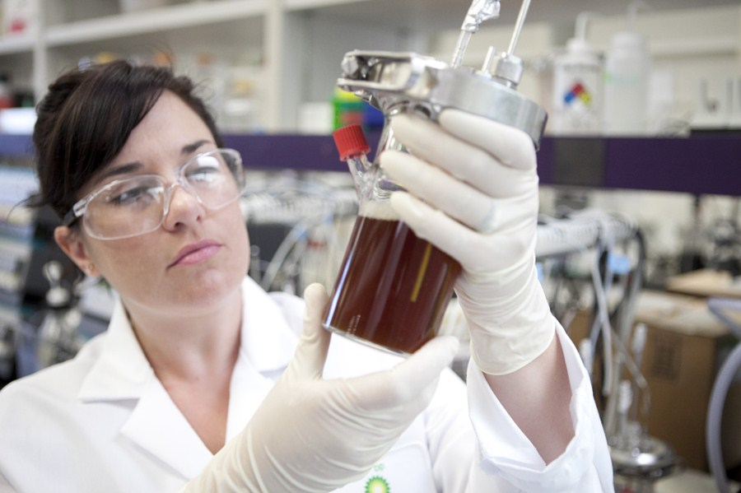
^{What do engineers do at BP?}
Discovering, extracting and processing oil is an important part of what we do…
BP Schools Link – Ex’straw’dinary Engineering
8

Slide 9
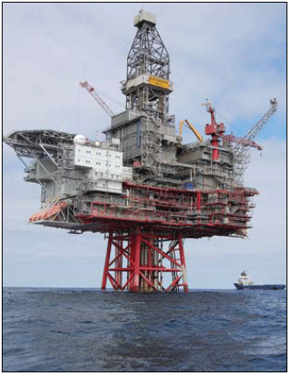
How is engineering used to get oil and gas?
Engineering plays a vital role in oil and gas extraction
Engineers help build the structures we need to get oil and gas out of the ground before it can be processed
To get oil and gas from under the sea bed, engineers build off shore oil platforms
BP Schools Link – Ex’straw’dinary Engineering
9

Slide 10
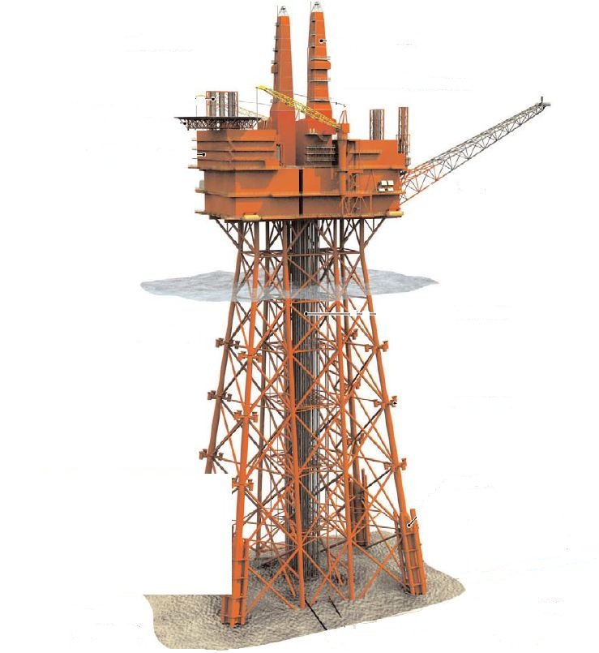
Offshore platforms are supported by ‘jacket structures’
Drilling derrick
Helideck
Accommodation block
Flare boom
Processing units
Pipelines
The jacket structure supports the topside and is fixed to the seabed with piles
BP Schools Link – Ex’straw’dinary Engineering
10

Slide 11
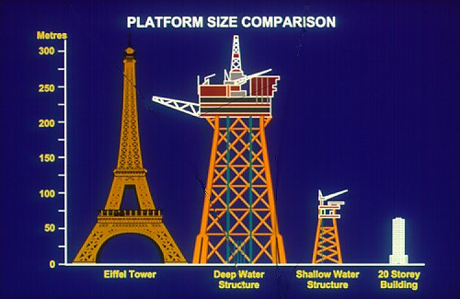
^{How big is a rig jacket?}
BP Schools Link – Ex’straw’dinary Engineering
11

Slide 12
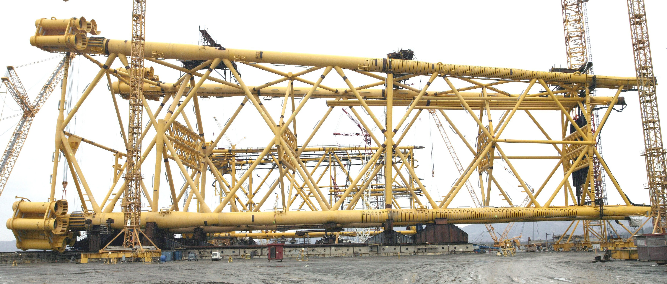
^{Very} ^{big!}
Clair rig jacket (North Sea)
BP Schools Link – Ex’straw’dinary Engineering
12

Slide 13
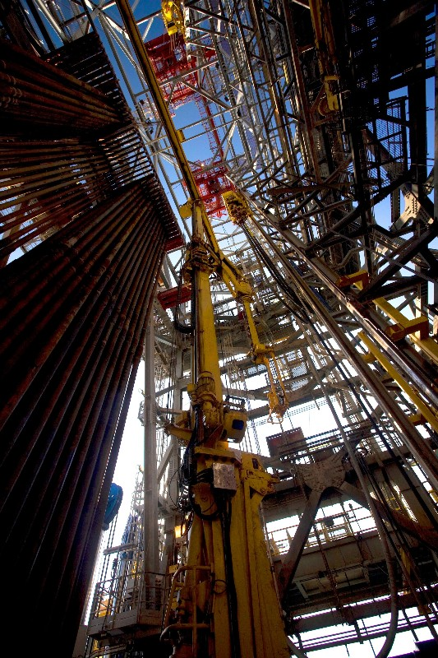
^{Your challenge (ages 11-14)}
BP needs a jacket structure for a new oil platform
Read the bid document
Review how you must respond in writing and by making a model
BP Schools Link – Ex’straw’dinary Engineering
13

Slide 14
^{Your challenge (ages 7-11)}
BP needs a new support structure for an oil platform
This needs to be strong and rigid
Think about what shapes you could use for your frame:
BP Schools Link – Ex’straw’dinary Engineering
14

Slide 15
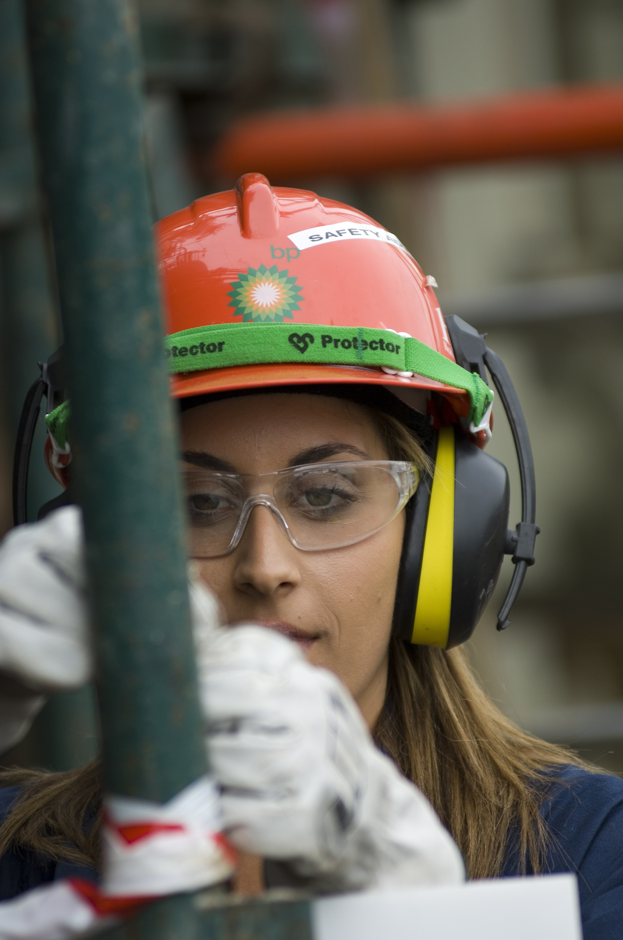
^{Your challenge}
Each straw and each marshmallow is worth $1 million
Don’t eat them!
The winner is the structure that can support the required design weight for the minimum cost
If you cut a straw or marshmallow you’ll be charged for the whole thing
BP Schools Link – Ex’straw’dinary Engineering
15

Slide 16
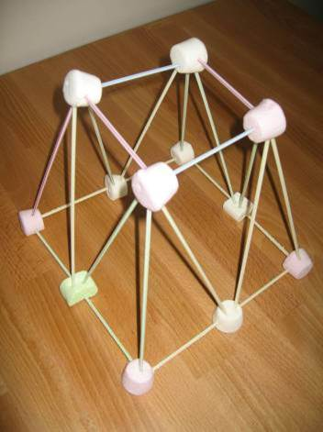
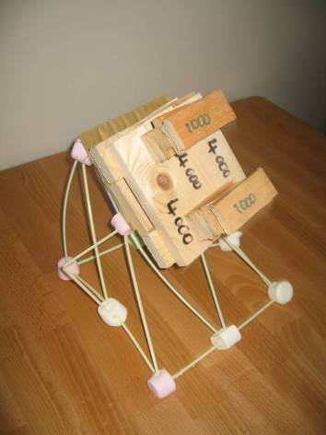
^{Will your design do the job?}
Your model will be tested for height and the weight it can support
BP Schools Link – Ex’straw’dinary Engineering
16

Slide 17
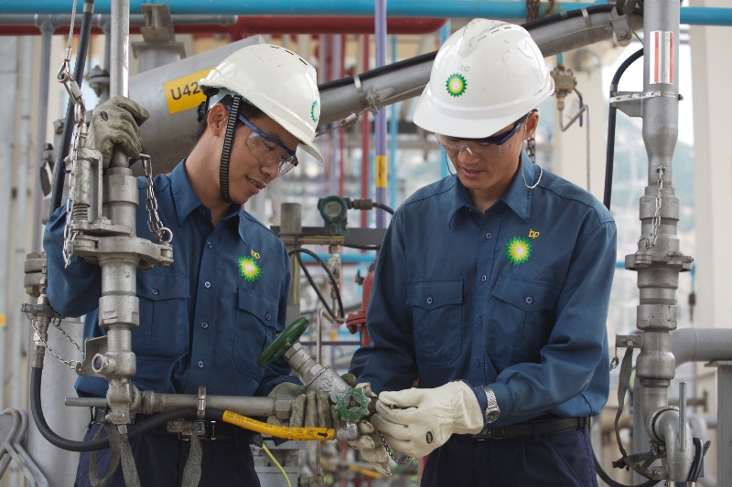
^{Working together}
Why might BP engineers need to work together?
Why is working together important?
How can YOU work together today?
BP Schools Link – Ex’straw’dinary Engineering
17

Slide 18
^{Evaluation}
What went well?
What could you improve?
How did you work together?
What skills did you use?
BP Schools Link – Ex’straw’dinary Engineering
18

Slide 19
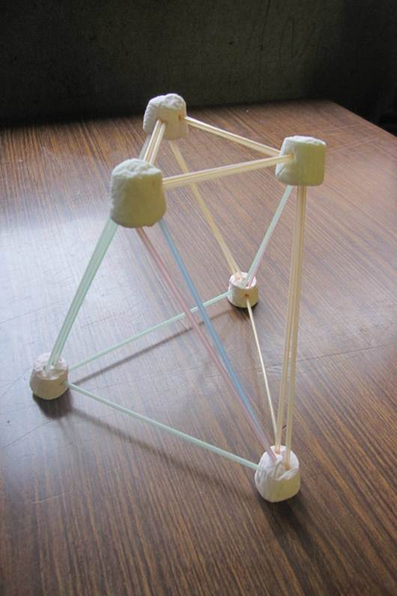
^{Great example!}
BP Schools Link – Ex’straw’dinary Engineering
19

Slide 20
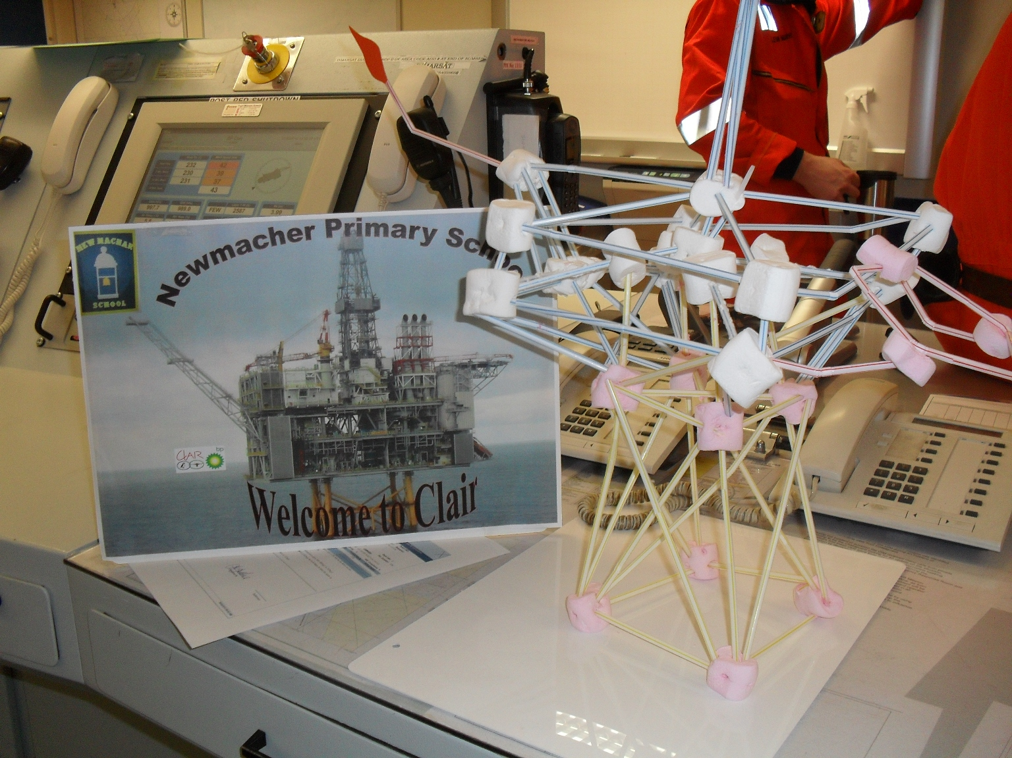
^{And look what else you can do!}
BP Schools Link – Ex’straw’dinary Engineering
20

