Slide 1
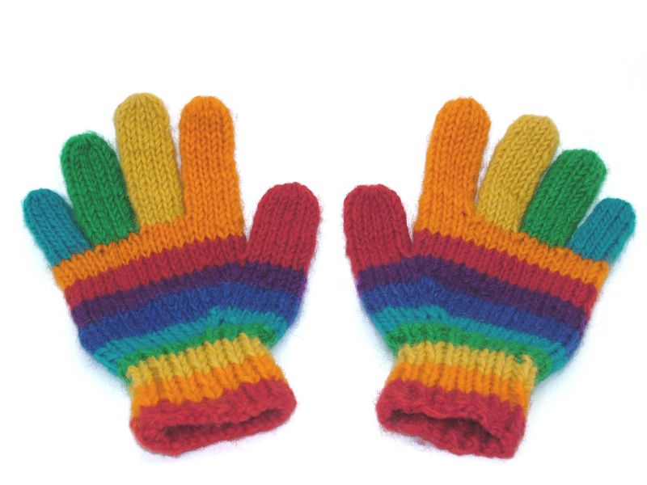
^{Handy Helpers}
^{BP Schools Link}

Slide 2
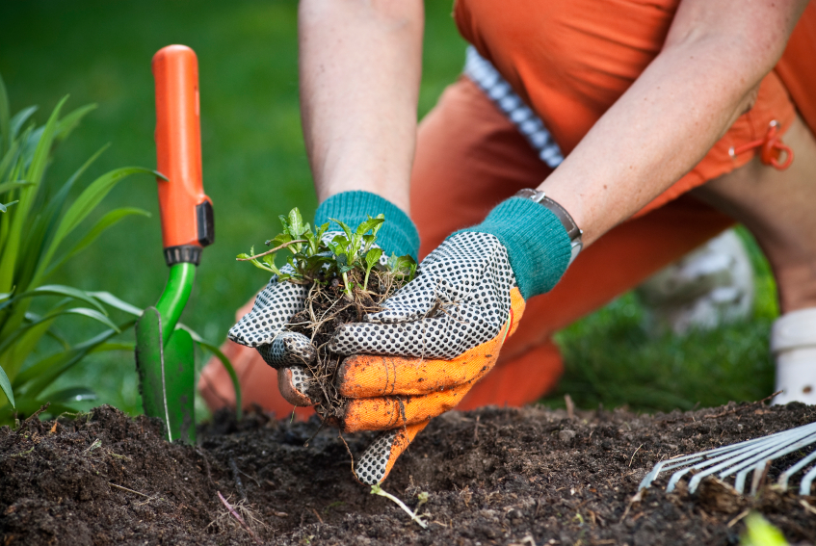
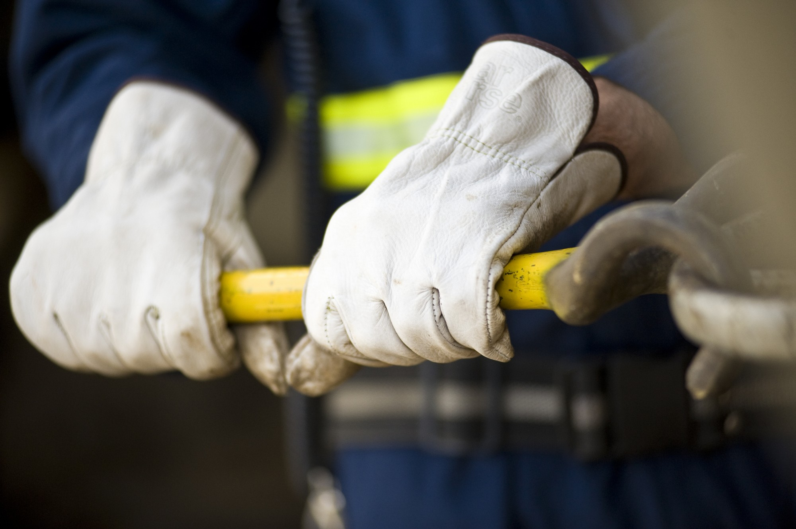
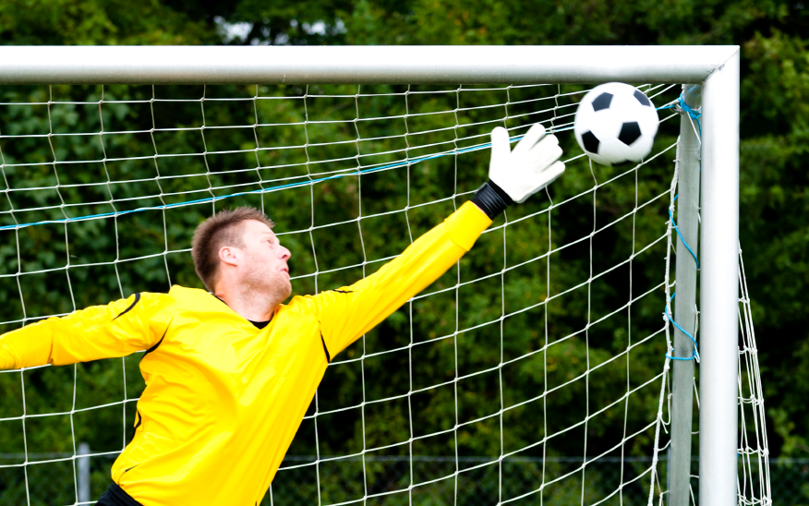
^{Gloves are our handy helpers}
BP Schools Link – Handy Helpers
2
Notes:
Space for you to write adjectives if possible

Slide 3
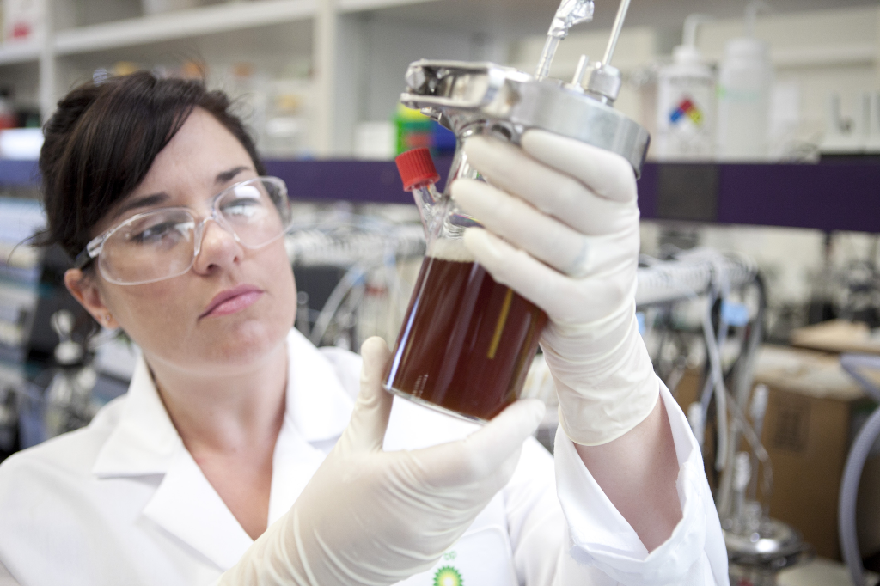
^{What do gloves help us do?}
… at home?
… at work?
… at play?
BP Schools Link – Handy Helpers
3

Slide 4
^{Describing our handy helpers}
BP Schools Link – Handy Helpers
4
Notes:
Space for you to write adjectives if possible

Slide 5
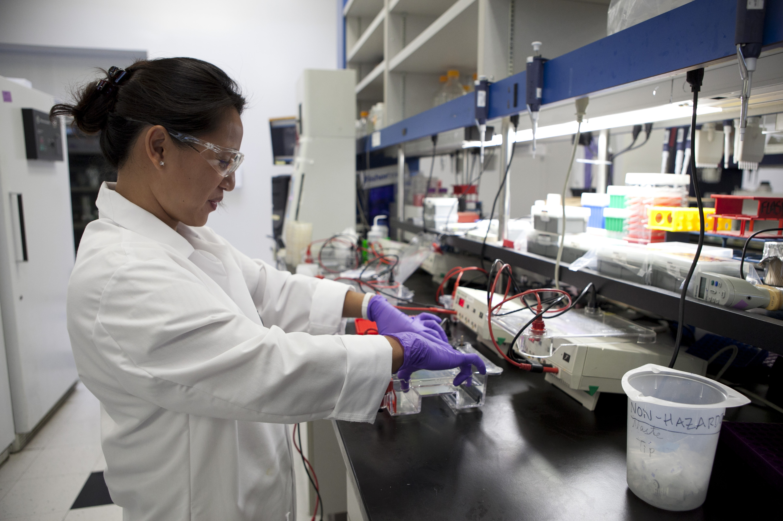
^{My handy helper day}
What gloves will help me do all my jobs?
BP Schools Link – Handy Helpers
5
Notes:
We suggest replacing this image with a picture of you wearing gloves.

Slide 6
^{Types of gloves}
BP Schools Link – Handy Helpers
6

Slide 7
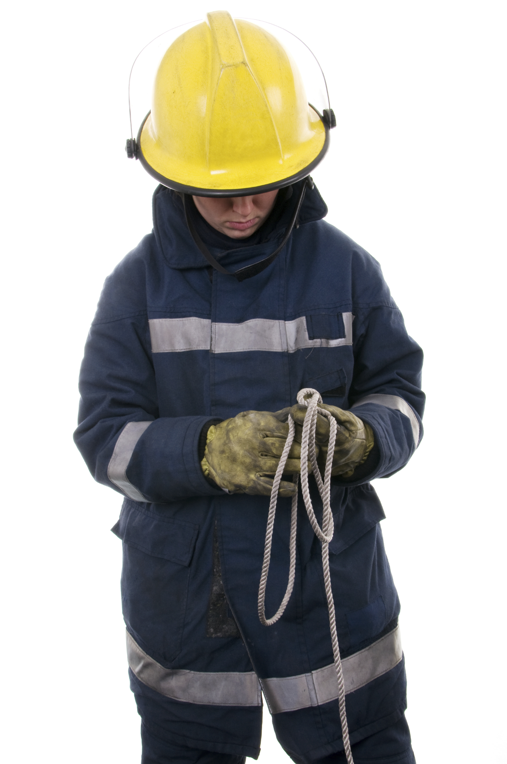
^{Types of gloves}
BP Schools Link – Handy Helpers
7

Slide 8
^{Types of gloves}
BP Schools Link – Handy Helpers
8

Slide 9
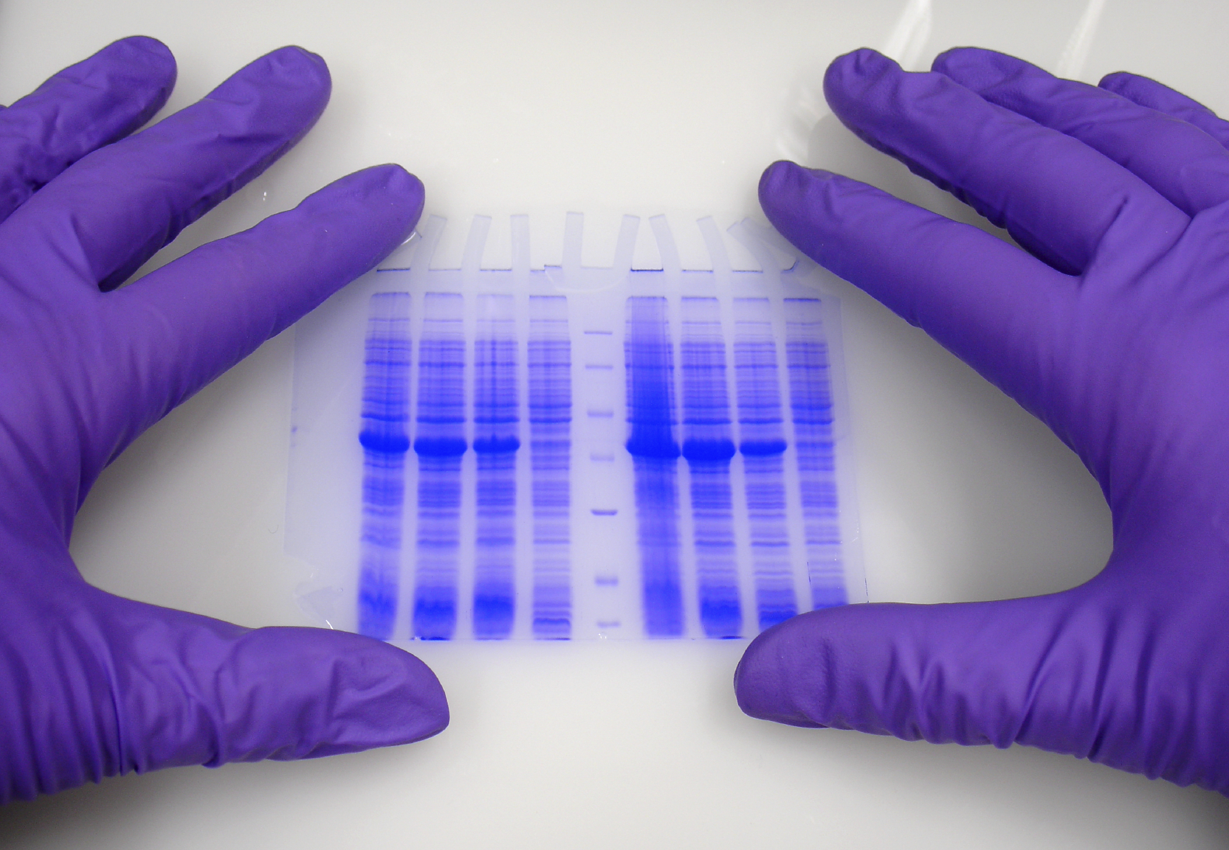
^{Types of gloves}
BP Schools Link – Handy Helpers
9

Slide 10
^{Types of gloves}
BP Schools Link – Handy Helpers
10

Slide 11
^{Types of gloves}
BP Schools Link – Handy Helpers
11

Slide 12
^{Types of gloves}
BP Schools Link – Handy Helpers
12

Slide 13
^{Our fair test}
What is our question?
What do we think will happen?
What will we change?
What will we keep the same?
How will we record our results?
BP Schools Link – Handy Helpers
13

