Slide 1
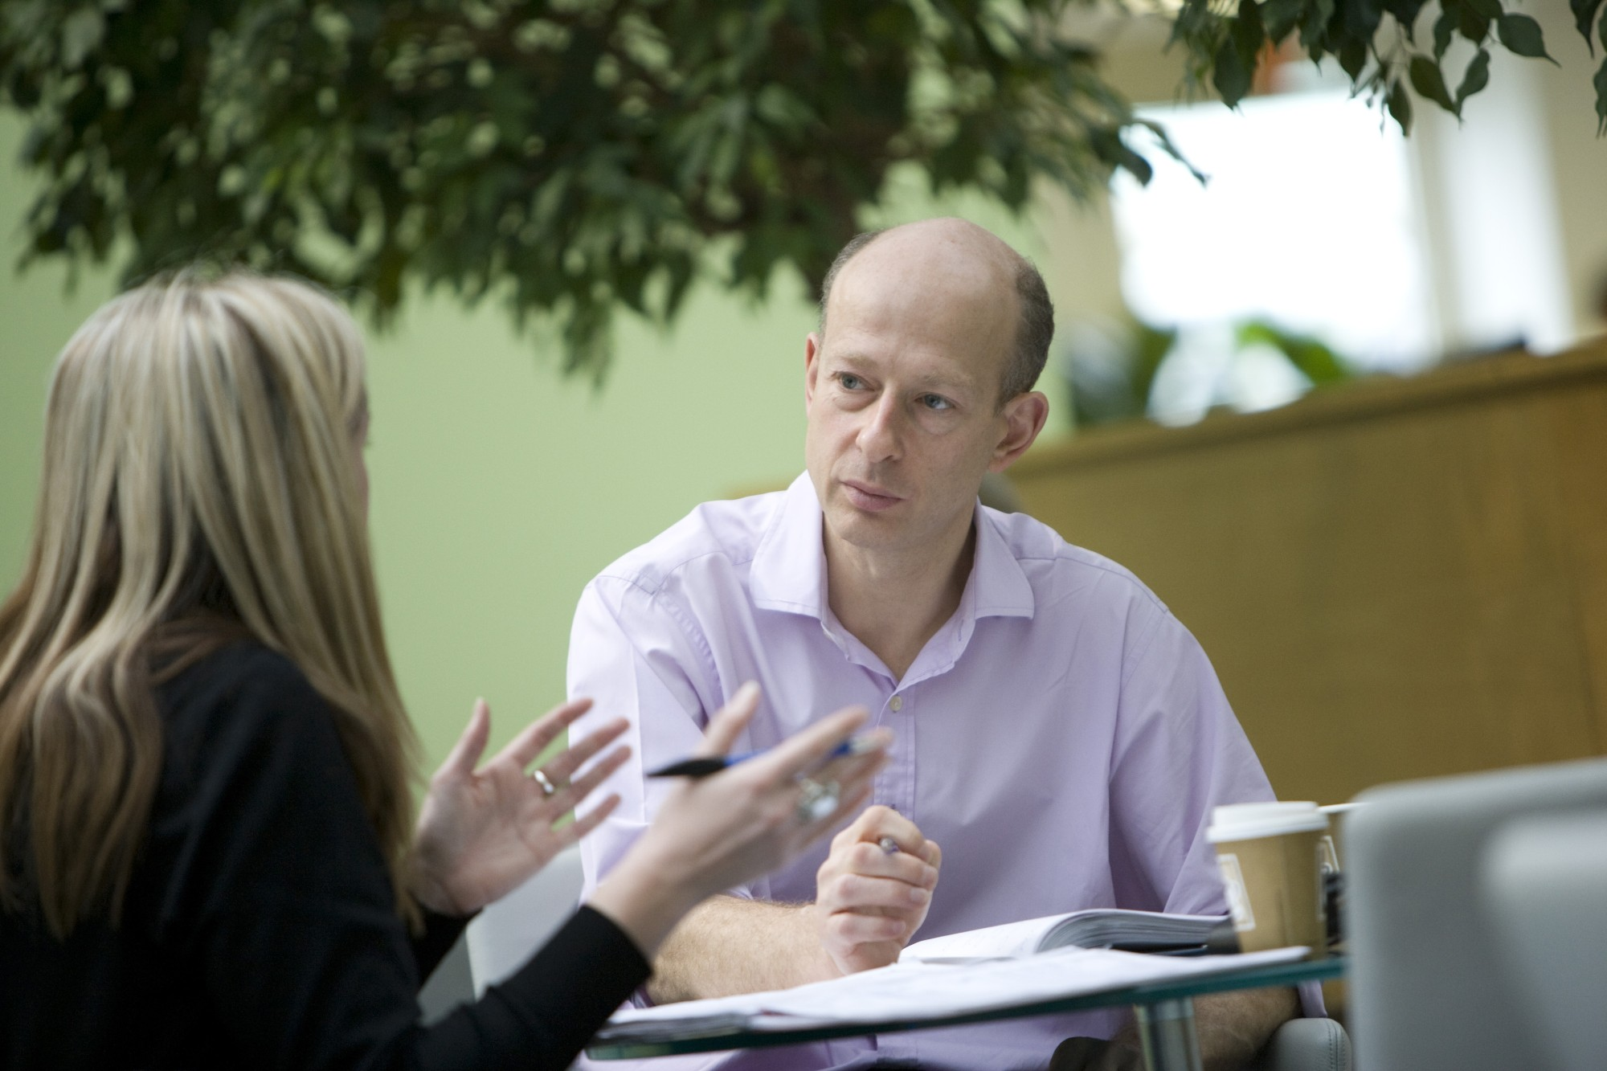
^{Mock Interview}

Slide 2
^{Why we’re here}
BP recruits graduates so the company has lots of experience of resumes, interviews and recruitment
The BP people here today have all been through interviews!
We’re here to help you practice your interview skills and tell you about the BP recruitment process
BP Schools Link – Mock Interview
2

Slide 3
^{Today’s objectives}
Competencies and why they are important
Dos and don’ts
Your chance to practice your interview technique in a competency interview
- interview
- initial feedback
Review and feedback to the whole group
BP Schools Link – Mock Interview
3

Slide 4
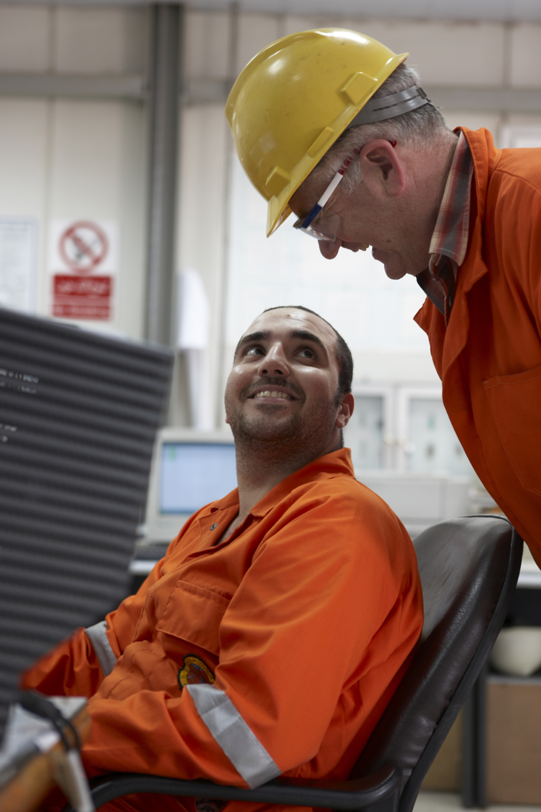
^{What are competencies?}
BP recruits people into lots of jobs, in lots of places and situations
At BP, we want everyone to share some characteristics we consider vital to our business, regardless of their role
These are the six BP competencies – skills we want every employee to be able to use
BP Schools Link – Mock Interview
4

Slide 5
^{Competencies}
Passion for knowledge and learning | can learn and apply knowledge good problem-solving analytical creative
Passion to excel | plans well and meets deadlines sets and achieves challenging goals doesn’t give up easily does things before being told to seizes opportunities and overcomes challenges adapts well to change
BP Schools Link – Mock Interview
5

Slide 6
^{Competencies}
Relating to people | can understand other people’s points of view listens well – easy to talk to does their share of teamwork helps others respects others and learns from them can take the lead when necessary
Technical | demonstrates depth of knowledge in a specialist area can develop new ideas from existing knowledge and information given
BP Schools Link – Mock Interview
6

Slide 7
^{Interviewing for competencies}
As well as general interview questions we’ll ask you two competency questions about
- passion to excel
- relating to people
Talk about what you have done, not what we or they have done
Don’t talk about:
- what you think you should have done
- what you think now
- what you hope to do in the future
…We’ll get this kind of information from other questions
BP Schools Link – Mock Interview
7

Slide 8
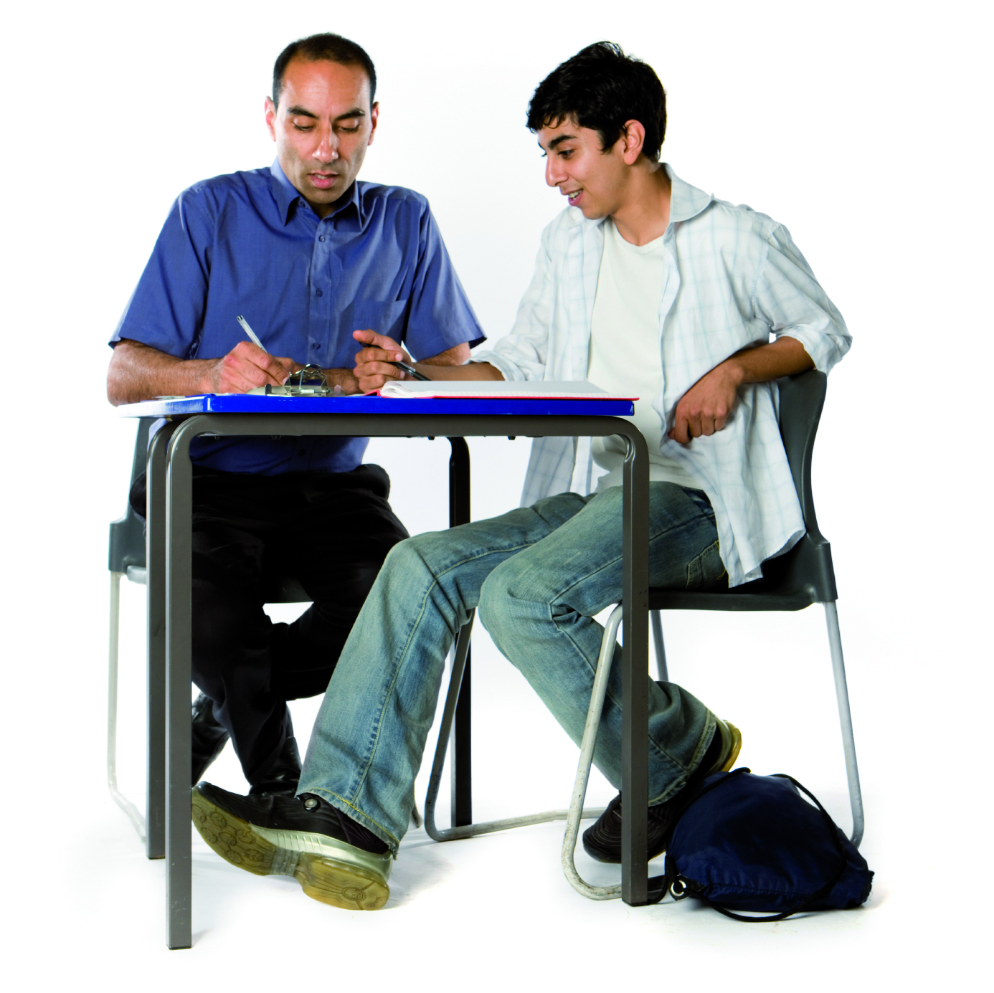
^{What do you think?}
What should and shouldn’t you do in your interview?
BP Schools Link – Mock Interview
8

Slide 9
^{Do:}
research the organization and its sector beforehand – keep up with the news
find out what the organization is looking for in its recruits – have examples of how you demonstrate these things
get a good night’s sleep
make sure your appearance is clean and smart, but be comfortable
plan your journey carefully and arrive on time
be prepared to answer questions about why you want the job and what you would bring to it
be yourself and be honest and confident – trust your own ideas
give a firm handshake, smile and make eye contact – sit upright but relaxed
answer the questions clearly – don’t waffle
BP Schools Link – Mock Interview
9

Slide 10
^{Don’t:}
forget to switch off your mobile
fidget – keep your hands on your lap or in front of you
worry if one part does not go as well as the rest
lie
be afraid to ask questions
be too pushy
chew gum
cross your arms
BP Schools Link – Mock Interview
10

Slide 11
^{Feedback}
What students did well?
What could be improved?
What have you gain from this activity?
Good luck when you do it for real!
BP Schools Link – Mock Interview
11

