Slide 1

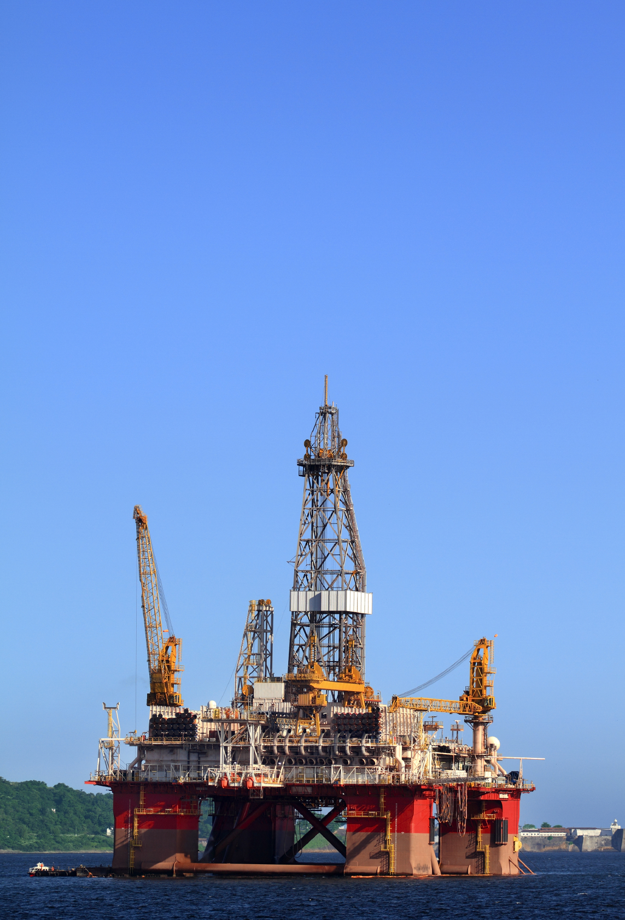
^{The Oil Extraction Challenge}
^{BP Schools Link}

Slide 2
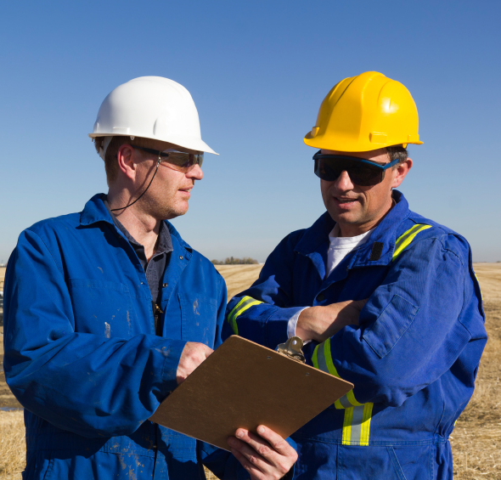
^{Your challenge}
Form an oil company and agree roles
Stake your claim for what you think is the best oil field to develop
Work as a team to invest in drilling and production
Manage your company to make the best profit you can over 10 years
BP Schools Link – Oil Extraction Challenge
2

Slide 3
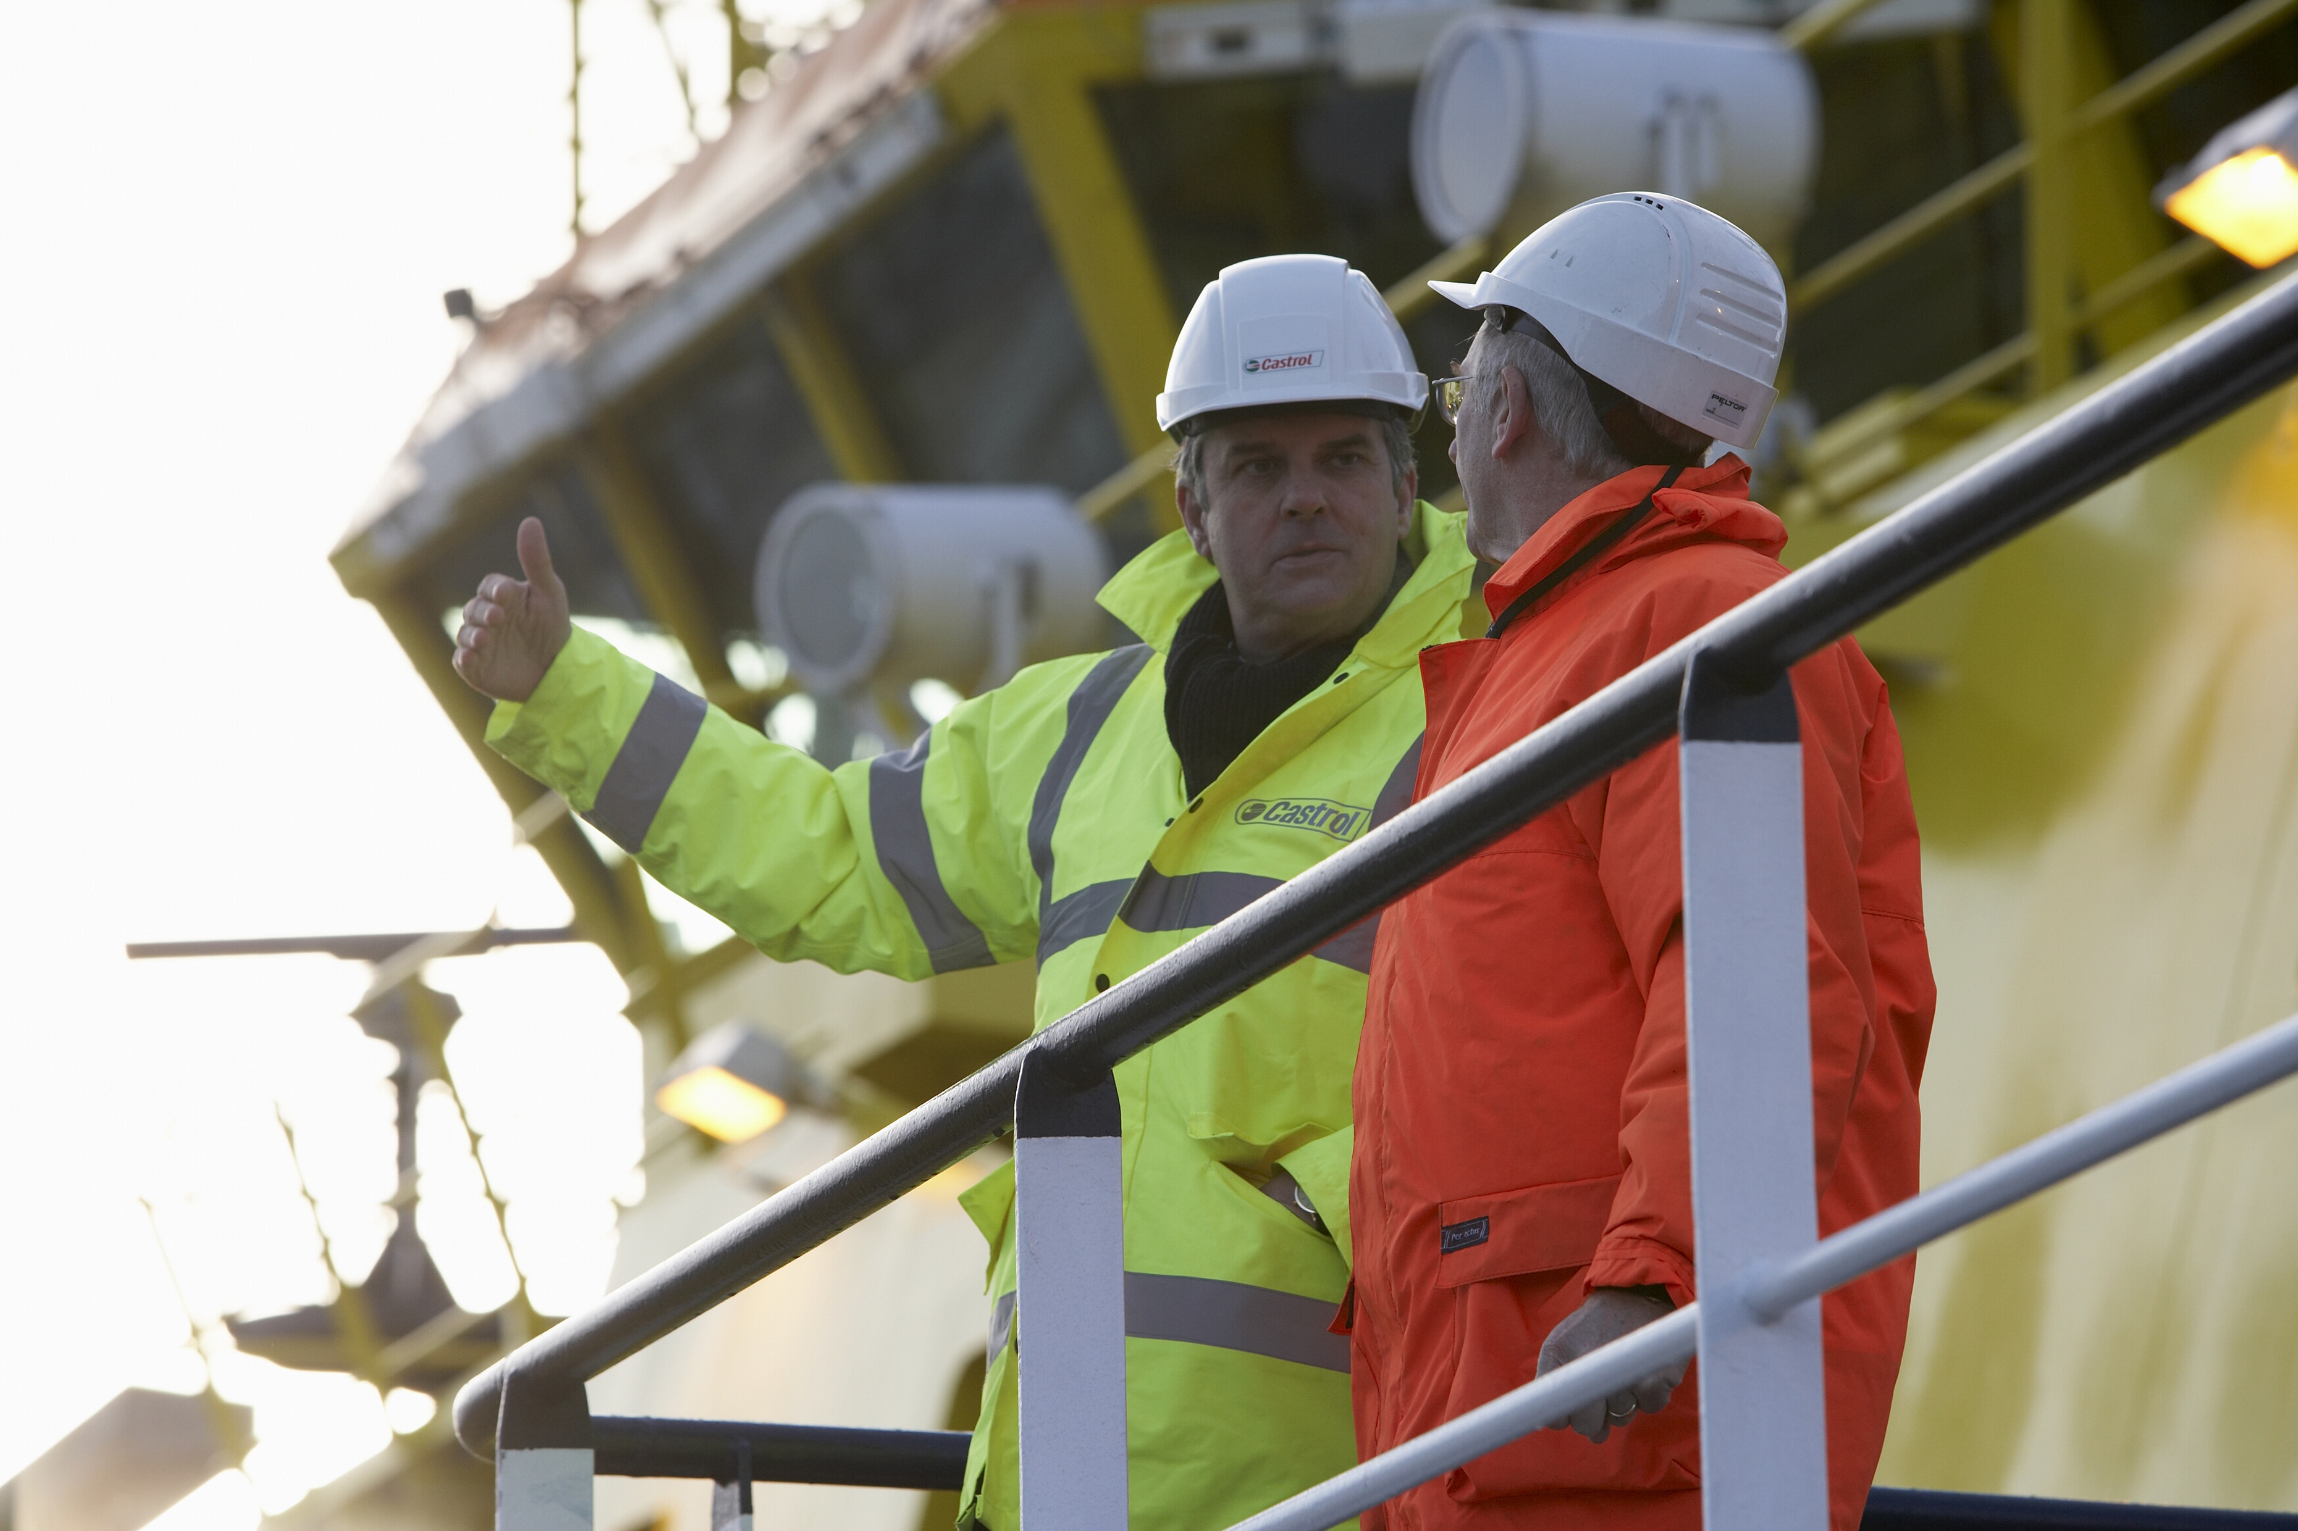
^{Oil industry briefing}
Welcome to the oil industry
You’ll need this information to help you make the right decisions
You’ll be given information, pictures and a video clip
Watch and listen carefully!
BP Schools Link – Oil Extraction Challenge
3

Slide 4
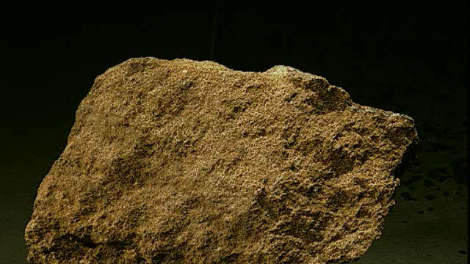
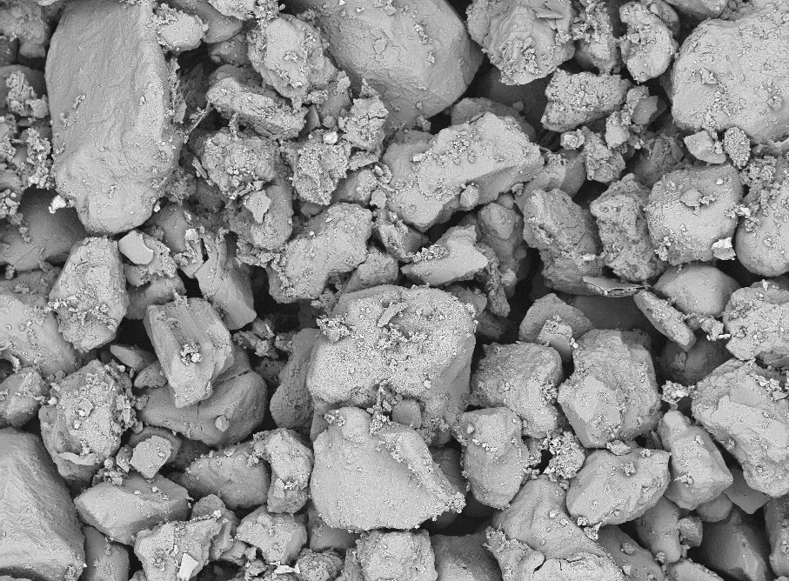
^{What is a reservoir?}
The volume of underground rock where oil and gas are trapped
Reservoirs aren’t empty caverns
The oil is trapped in tiny spaces within porous rocks, like sandstones and shale
BP Schools Link – Oil Extraction Challenge
4

Slide 5
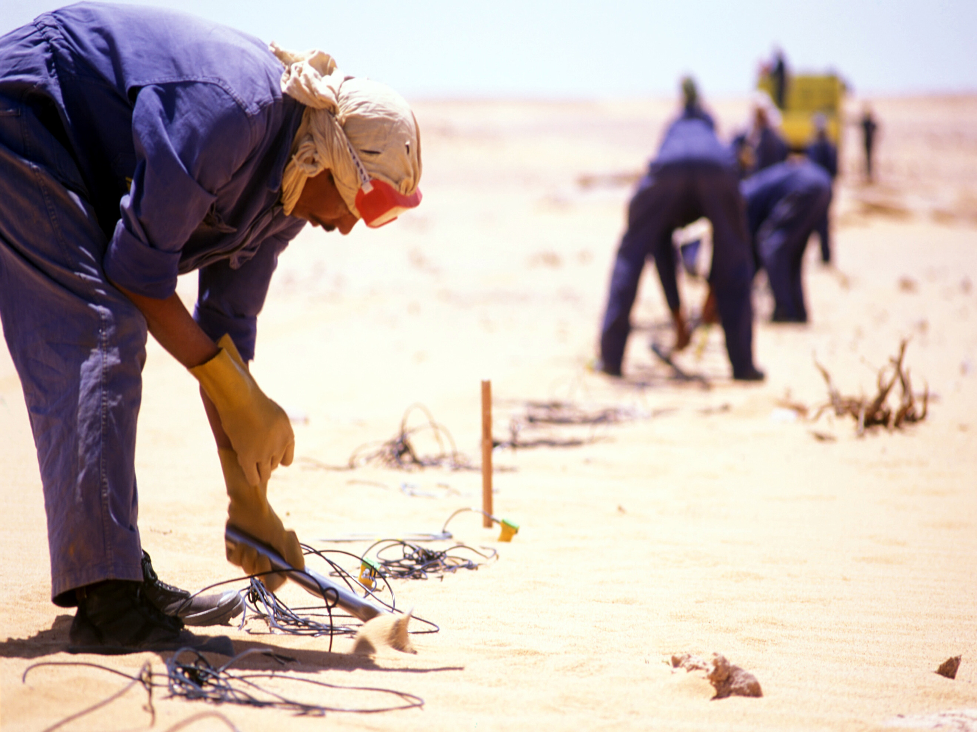
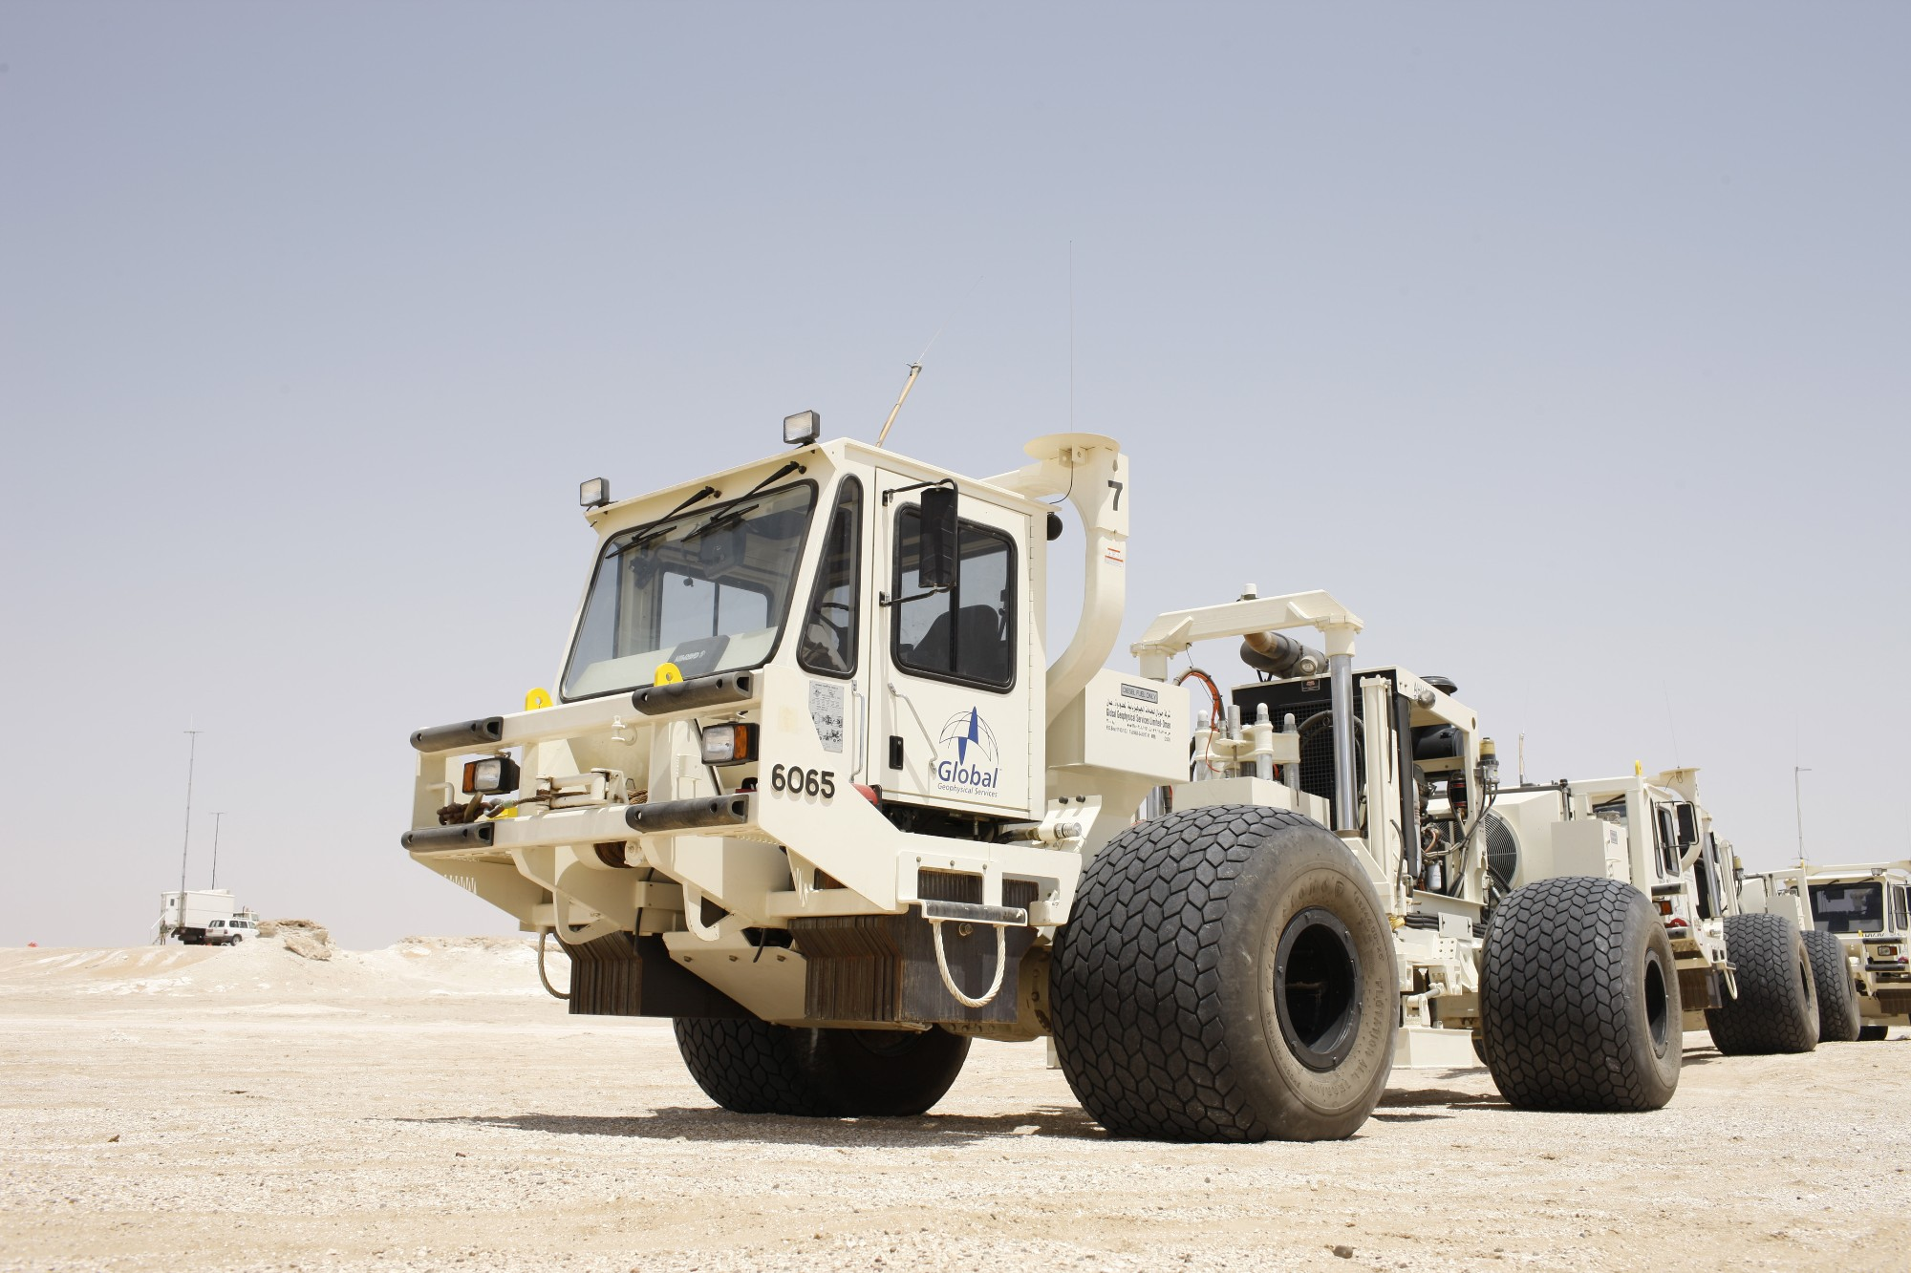
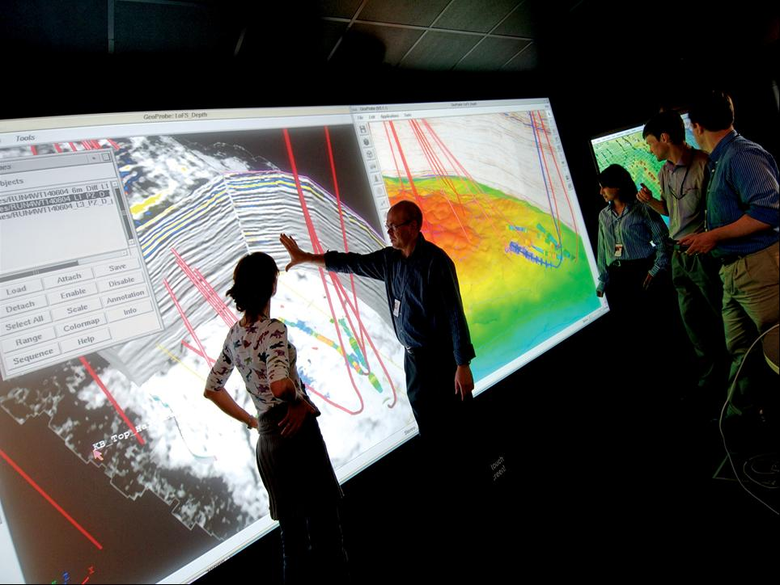
^{How do we find oil and gas?}
Drilling is the only way to find out if oil and gas is underground
Prospectors 100 years ago dug where they saw oil seeping or bubbling to the surface
Now we use seismic imaging to try to interpret what is down there
Geologists send sounds through the ground and interpret the echoes that bounce back up
BP Schools Link – Oil Extraction Challenge
5

Slide 6
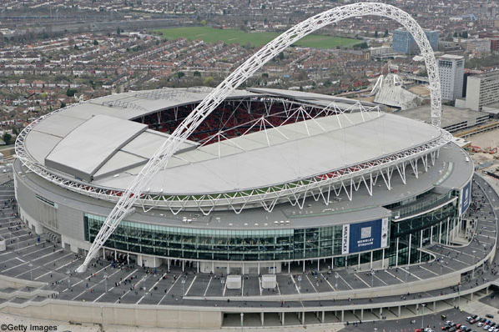
^{How big is an oil reservoir?}
Huge!
Can be over a mile deep
Could hold 1 million to several billion barrels
100 million barrels would fill Wembley Stadium 4 times!
BP Schools Link – Oil Extraction Challenge
6
Notes:
You may wish to personalise the map to show your local area.

Slide 7
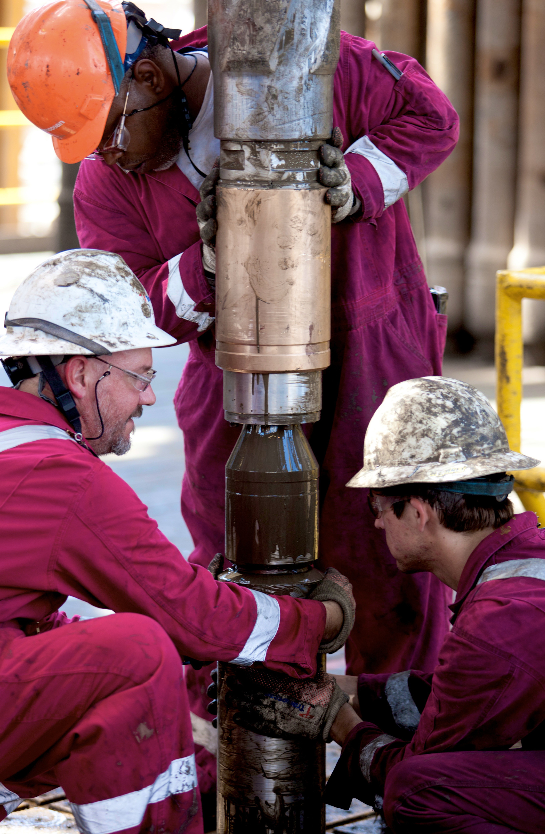
How do we get the oil out of the ground?
The drilling team drills down through the rock with a diamond or tungsten drill bit
‘Mud’ (a mixture of water, clay and other additives) is pumped down to cool and lubricate the drill bit
The oil, mud and bits of rock that come back up indicate if there is a reservoir
Then other monitoring equipment is sent down the well to analyse the reservoir in more detail
BP Schools Link – Oil Extraction Challenge
7

Slide 8
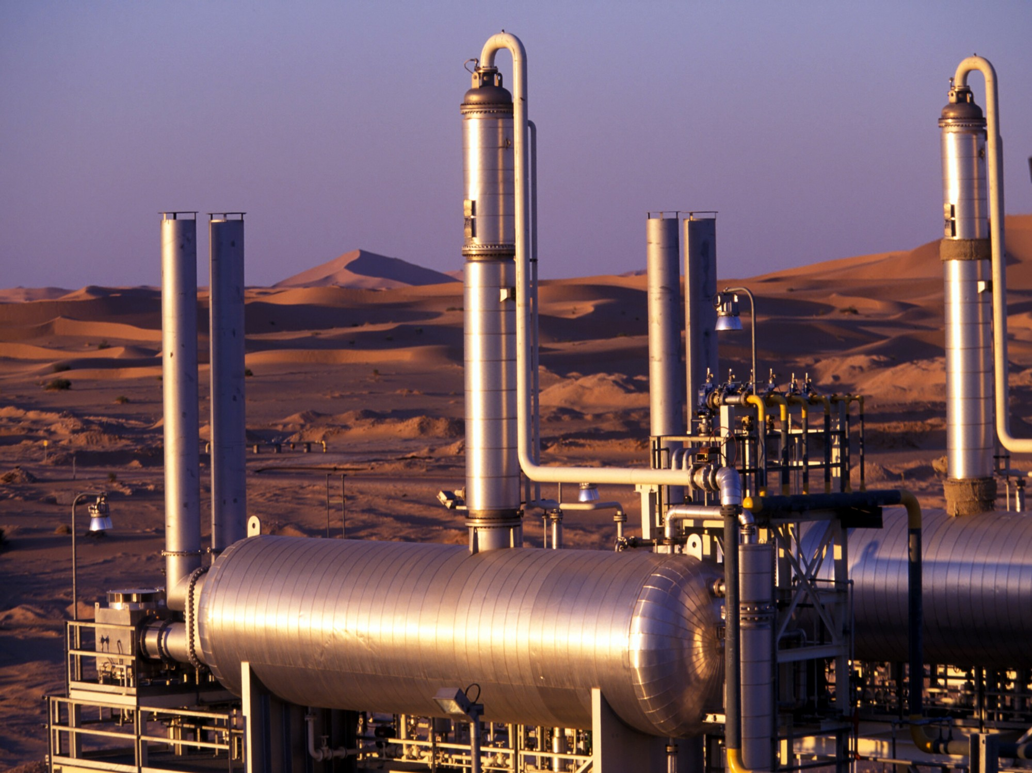
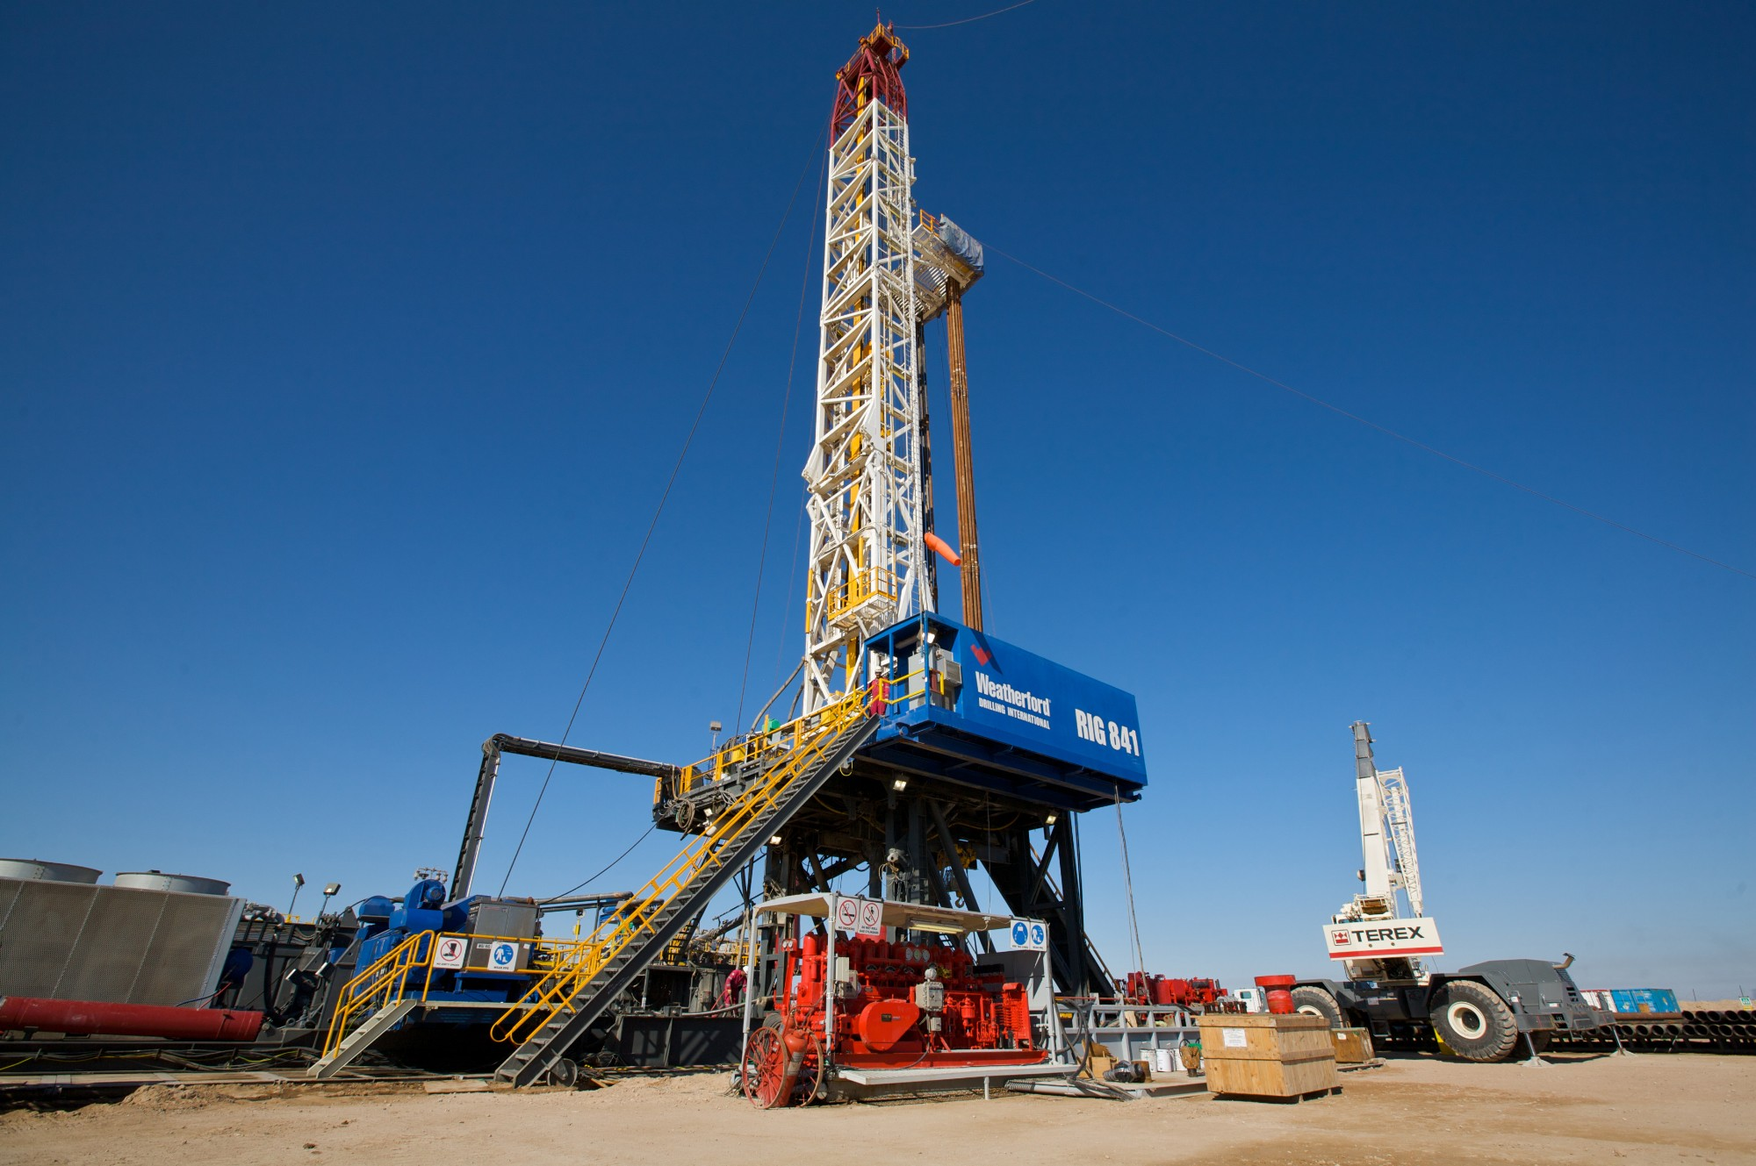
^{Reservoirs can be under land…}
On land all the equipment for drilling and production must be transported to the site which is often very remote, accessible only by helicopter
A pump is positioned over the well to extract the oil and gas
Also needed are:
  Storage and processing facilities
  Transportation routes
BP Schools Link – Oil Extraction Challenge
8

Slide 9
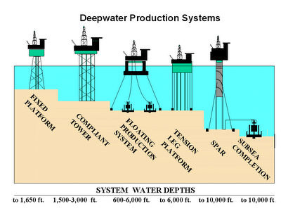
^{or under the sea…}
Off shore facilities cost billions of dollars and take years to build
Some are anchored to the ground but in deeper water the floating structure is held in place with a combination of anchors and GPS-led thrusters
The facilities must stand up to 100m waves and not move an inch!
Some equipment is positioned on top of the platform and some on the seabed
BP Schools Link – Oil Extraction Challenge
9

Slide 10
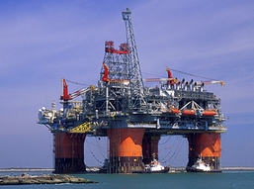
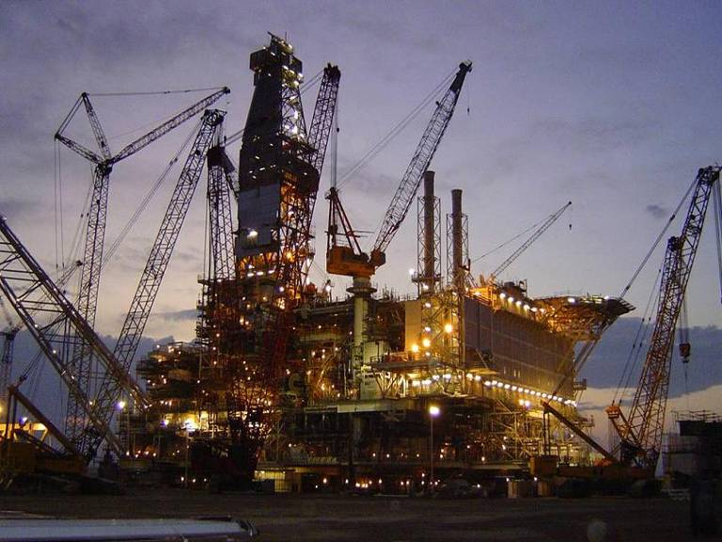
^{Production facilities}
Most facilities include:
    Storage and separation tanks
    Pumps and pipelines
    Utilities (power/wate)
    Office space
    Monitoring equipment
    Facilities for the staff incl restaurant/gym/sleeping quarters
    A helipad
BP Schools Link – Oil Extraction Challenge
10
Notes:
10

Slide 11
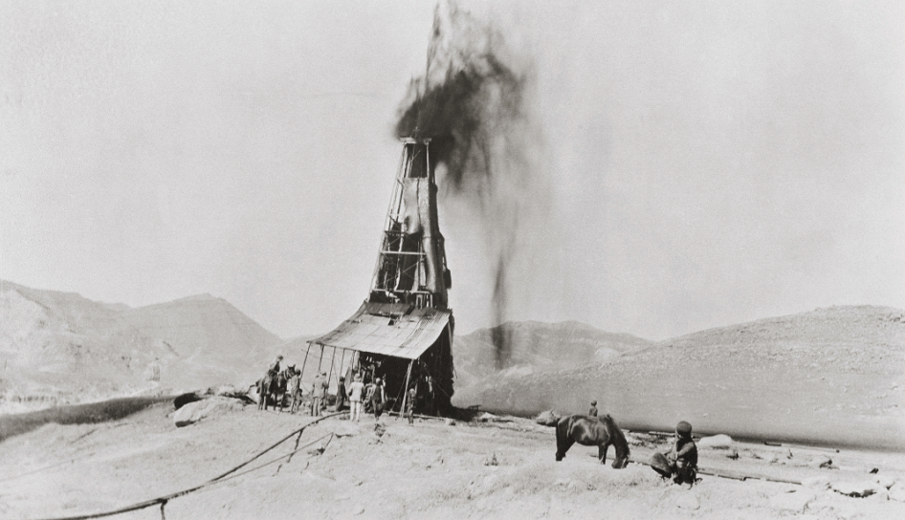
^{Extracting oil with pressure}
The oil is under pressure in the reservoir
At first the pressure pushes it out easily
Over time this natural pressure reduces
By the time the pressure has equalized, only some of the oil has been extracted
Oil under natural pressure gushing out of the first oil discovery in Persia in 1908
BP Schools Link – Oil Extraction Challenge
11

Slide 12
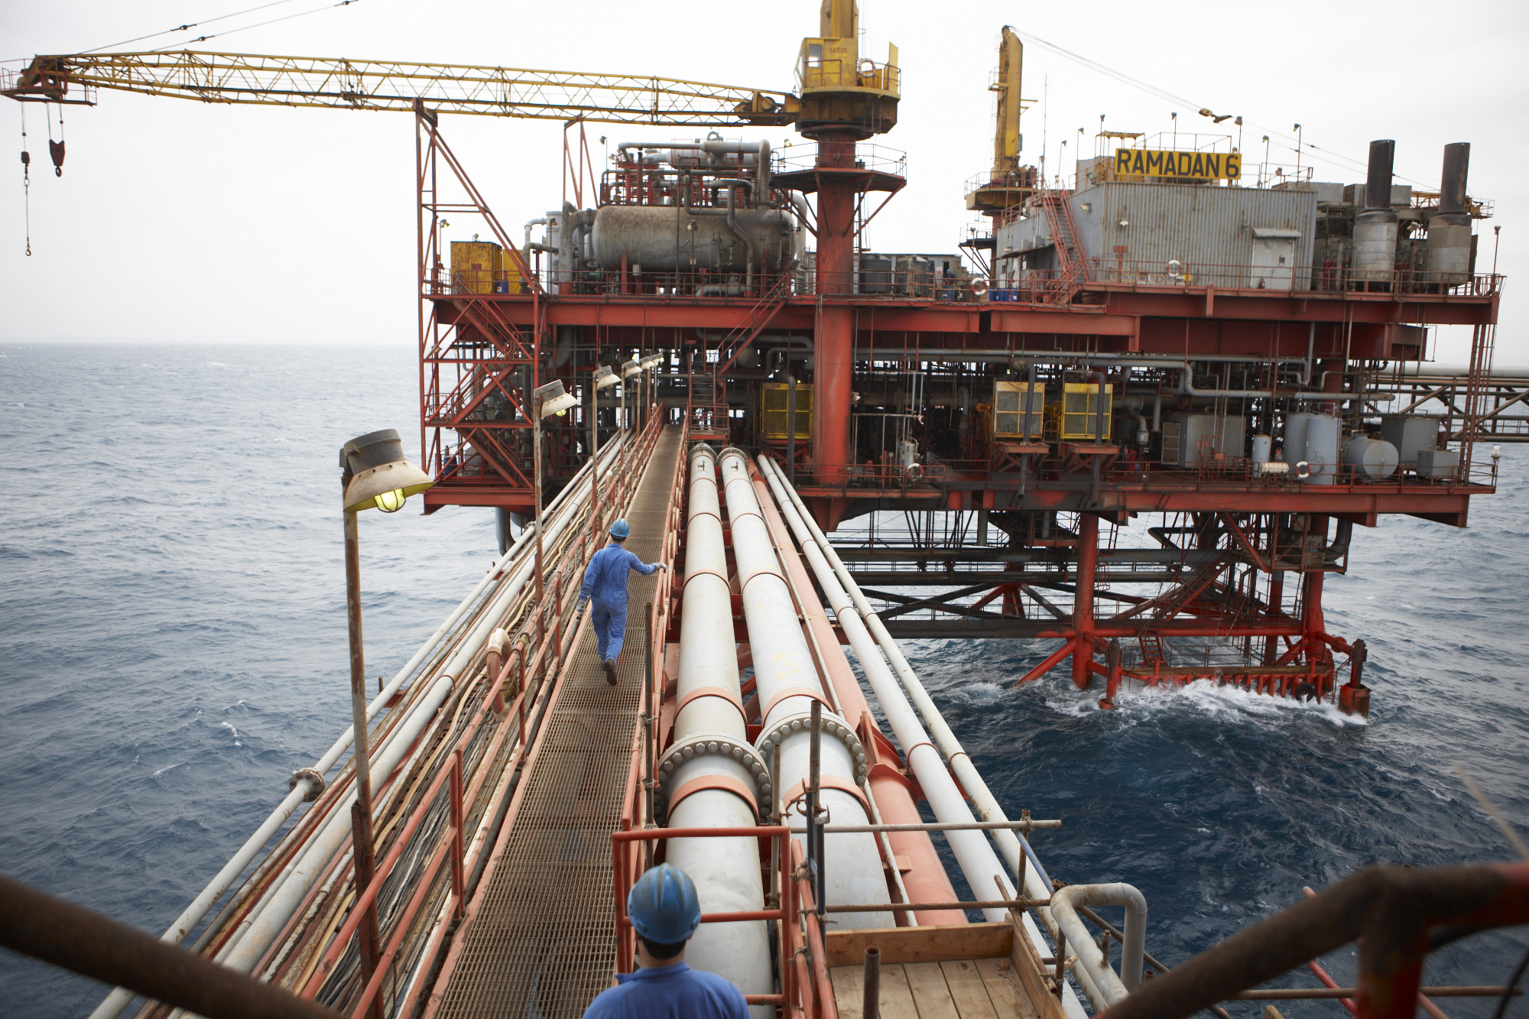
^{How can we extract more oil?}
Injecting water or gas into the reservoir sweeps the oil towards the well
This pressure carries on pushing oil out of the reservoir allowing much more of the oil to be extracted
Injection wells must be drilled in the right places to push oil towards the production wells
Pipes are needed to link the injection equipment to the water source
BP Schools Link – Oil Extraction Challenge
12

Slide 13
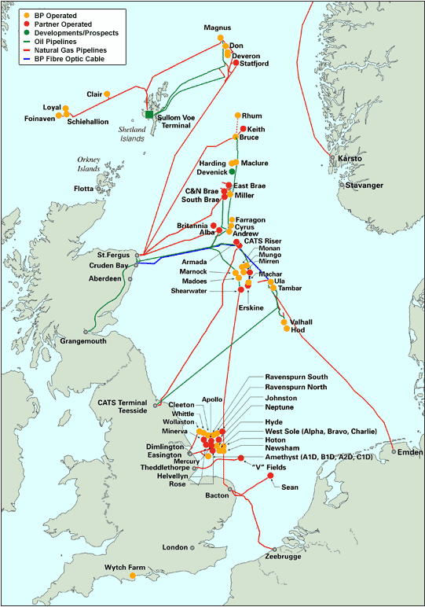
^{Sharing facilities}
Some smaller reservoirs don’t have their own production facilities. They ‘tie in’ to existing facilities on bigger fields
To ‘tie in’, pipes are laid to transport the oil from the new wells to the existing production facility
This cuts down operating costs, as there’s no need to invest in new facilities
Network of reservoirs and transportation pipelines in N. Sea
BP Schools Link – Oil Extraction Challenge
13

Slide 14

^{Profit: the big picture}
Oil companies are owned by their shareholders
They must give shareholders a return on their investment in the company
They must therefore seek the best return on their investments in new oil production
The skills and decisions of scientists, technologists and engineers are vital for oil companies to perform well and reward their investors
BP Schools Link – Oil Extraction Challenge
14

Slide 15

^{Form your oil company}
Give your company a name
Agree who will take on each role
Read your Role Cards to find out
    Who you are
    What you must do
You have 5 minutes to do this!
BP Schools Link – Oil Extraction Challenge
15

Slide 16
^{Key business roles}
Chief Executive Officer
Finance Director
Facilities Manager
Reservoir Engineer
Risk Analyst
BP Schools Link – Oil Extraction Challenge
16

Slide 17
^{Balancing risk and reward}
Every new development has risks which must be weighed against the rewards
These may affect people, the environment or oil/gas production
In planning a new development a detailed risk assessment is carried out and possible risks identified
Steps are taken to reduce risks, but if a risk is too unmanageable the development won’t go ahead
BP Schools Link – Oil Extraction Challenge
17

Slide 18
^{What types of risk are there?}
Political
Environmental
Commercial
BP Schools Link – Oil Extraction Challenge
18

Slide 19
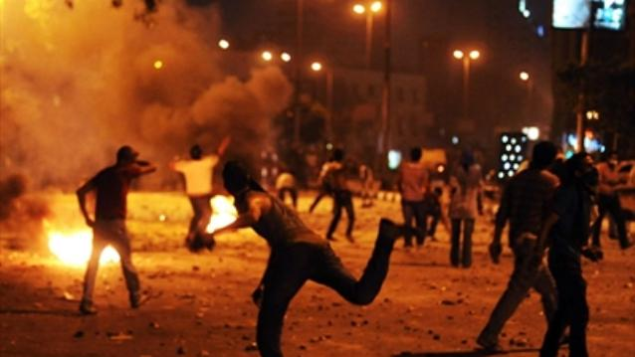
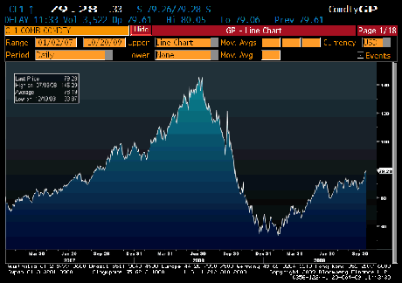
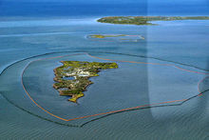
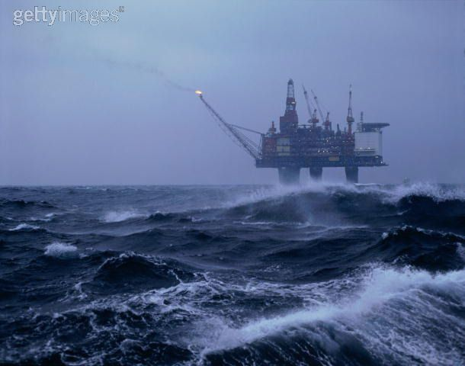
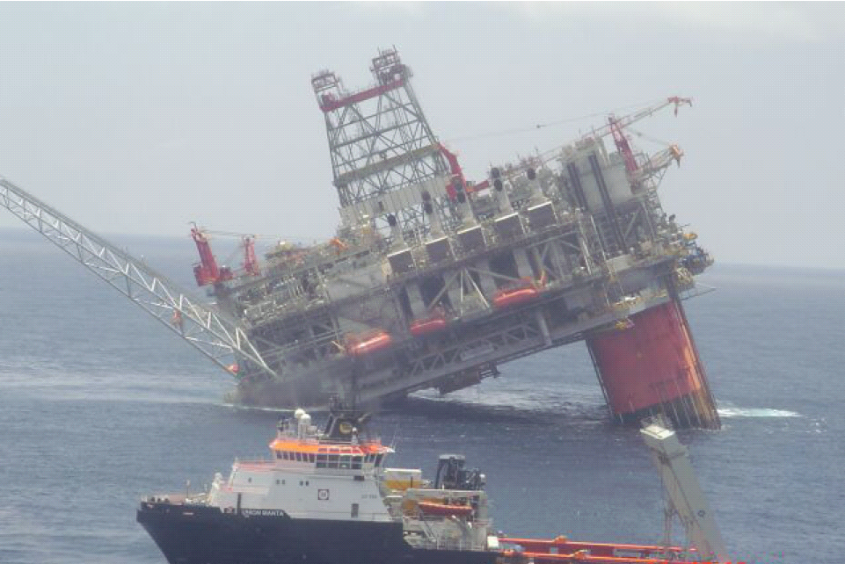
^{What types of risk are there?}
Market risk
Political risk
Weather risk
Environmental risk
Technology failure
BP Schools Link – Oil Extraction Challenge
19

Slide 20
^{Block options}
A ‘block’ is an area of land or sea
Blocks don’t necessarily have oil underneath
You must bid for ONE block:
    Block A and Block B: North Sea
    Block C and Block D: Middle East (desert)
    Block E and Block F: West Africa (offshore)
BP Schools Link – Oil Extraction Challenge
20

Slide 21
^{Bid for a block}
Review the information on the Block Data sheets
Agree which block you’ll bid for, and why
Submit your bid – first come, first served!
BP Schools Link – Oil Extraction Challenge
21

Slide 22
Submit your development investment
Read the detailed Block Data for your location and the four development options
Discuss the pros and cons of each option
Use calculators to help you calculate the possible profit for each option
Remember that you’re taking a risk: your data are just the best predictions available and may change in the future
BP Schools Link – Oil Extraction Challenge
22

Slide 23
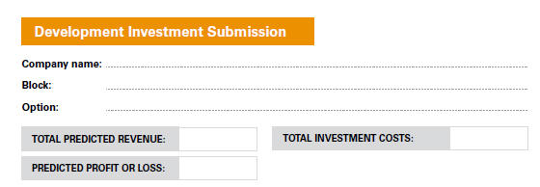
^{Development investment}
BP Schools Link – Oil Extraction Challenge
23

Slide 24
^{Operation – what you will do}
You will see news summaries for years 1 – 10 as well as the oil price
Only some events will affect your company
Adjust your spreadsheet with the new oil price
Make note of any news that affects you
Revise your financial forecast
Submit your Annual Financial Report with your updated 10-year forecast
BP Schools Link – Oil Extraction Challenge
24

Slide 25
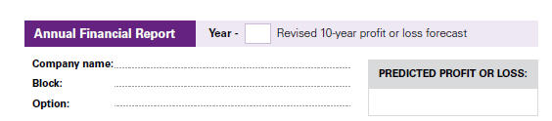
^{Annual Financial Report}
BP Schools Link – Oil Extraction Challenge
25

Slide 26
^{Year 1 news}
Oil price $130
There is a nuclear power plant shutdown in the USA
Oil is in demand
Oil prices are higher than predicted
BP Schools Link – Oil Extraction Challenge
26

Slide 27
^{Year 2 news}
Oil price $140
China has shown a sharp increase in demand, pushing oil prices higher
West Africa and North Sea: You have the option of investing in infill drilling to see if you can access more reserves
This means investing another $50 million now
Oil may or may not be found
BP Schools Link – Oil Extraction Challenge
27

Slide 28
^{Year 3 news}
Oil price $90
Exploration in recent years in Brazil has started producing lots of new oil, so oil prices have fallen
Additional information is available to Risks Analysts. Share this with your team after they have submitted their Year 3 Annual Financial Report
BP Schools Link – Oil Extraction Challenge
28

Slide 29
^{Year 4 news}
Oil price $70
A quiet year
Hijackers retreat from West African waters to regroup
No further unexploded ordnance is discovered in the North Sea
The political situation in the Middle East remains uncertain but there is no immediate threat
BP Schools Link – Oil Extraction Challenge
29

Slide 30
^{Year 5 news}
Oil price $90
The activists in the Middle East cause a political uprising
There have been attacks on staff working at oil and gas producing facilities
If you didn’t choose to relocate your employees to keep them safe you will have to do so now
Negotiations will take a year, so no oil production this year
BP Schools Link – Oil Extraction Challenge
30

Slide 31
^{Year 6 news}
Oil price $80
Boom!
A WW2 bomb in the North Sea explodes as the sea bed shifts
If you didn’t choose to remove the bomb it blasts a hole in your pipeline which you have to repair.
You won’t be able to produce oil this year because the pipeline must be mended
BP Schools Link – Oil Extraction Challenge
31

Slide 32
^{Year 7 news}
Oil price $50
Oil companies in the Middle East hit oil
The wells drilled into the deeper reservoir discover a huge reserve of 100 million barrels and start production immediately
This pushes the price of oil down
BP Schools Link – Oil Extraction Challenge
32

Slide 33
^{Year 8 news}
Oil price $60
Hijackers have re-launched their attacks on West African oil production facilities
If you chose not to invest in protection, they could board your facility and damage it, so you must shut down for a year
No oil production this year
BP Schools Link – Oil Extraction Challenge
33

Slide 34
^{Year 9 news}
Oil price $80
Infill drilling has accessed extra oil in the North Sea
The reservoir size has increased by 5 million barrels
This will increase yearly production totals from Year 9 onwards
BP Schools Link – Oil Extraction Challenge
34

Slide 35
^{Year 10 news}
Oil price $100
Infill drilling has accessed extra oil in the West African region
The reservoir size has increased by 5 million barrels
This will increase yearly production totals in Year 10
BP Schools Link – Oil Extraction Challenge
35

Slide 36
^{Final reports}
Make sure you have made all the changes to your financial projections
Submit your final Annual Financial Report showing your actual performance over 10 years
Make sure you have responded to all events that affect you
BP Schools Link – Oil Extraction Challenge
36

Slide 37
^{Winners}
Which company made the largest profit?
Which events affected you the most?
Which risks did you take and were they worth it?
Which decisions would you change?
BP Schools Link – Oil Extraction Challenge
37

