Slide 1

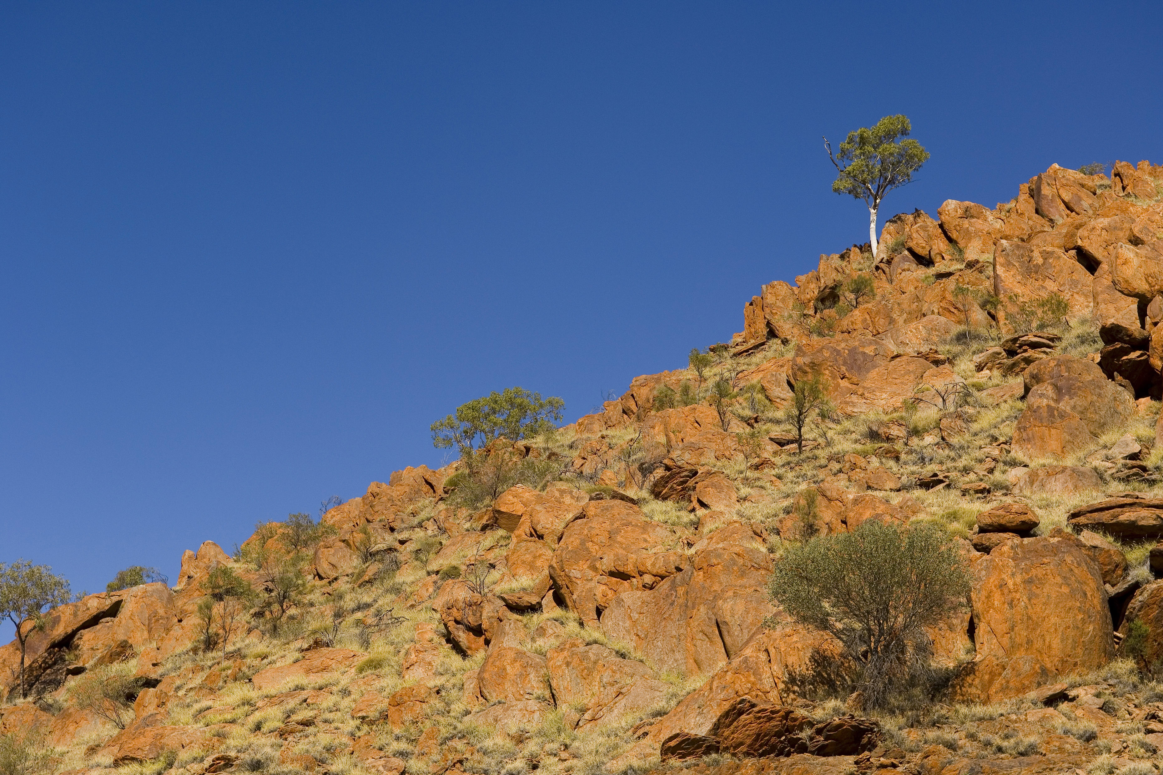
^{Rocks and Fossils}
^{BP Schools Link}

Slide 2
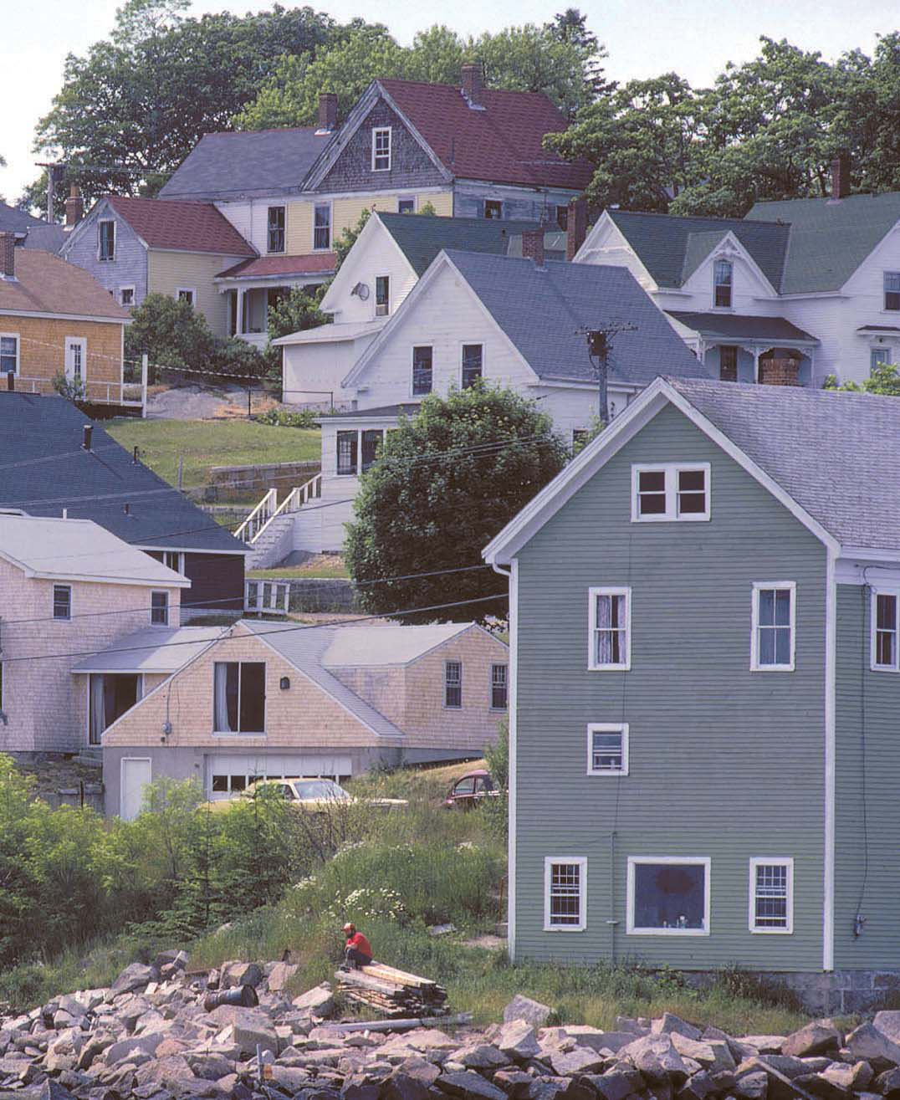
^{Pic 1}
BP Schools Link – Rocks and Fossils
2

Slide 3
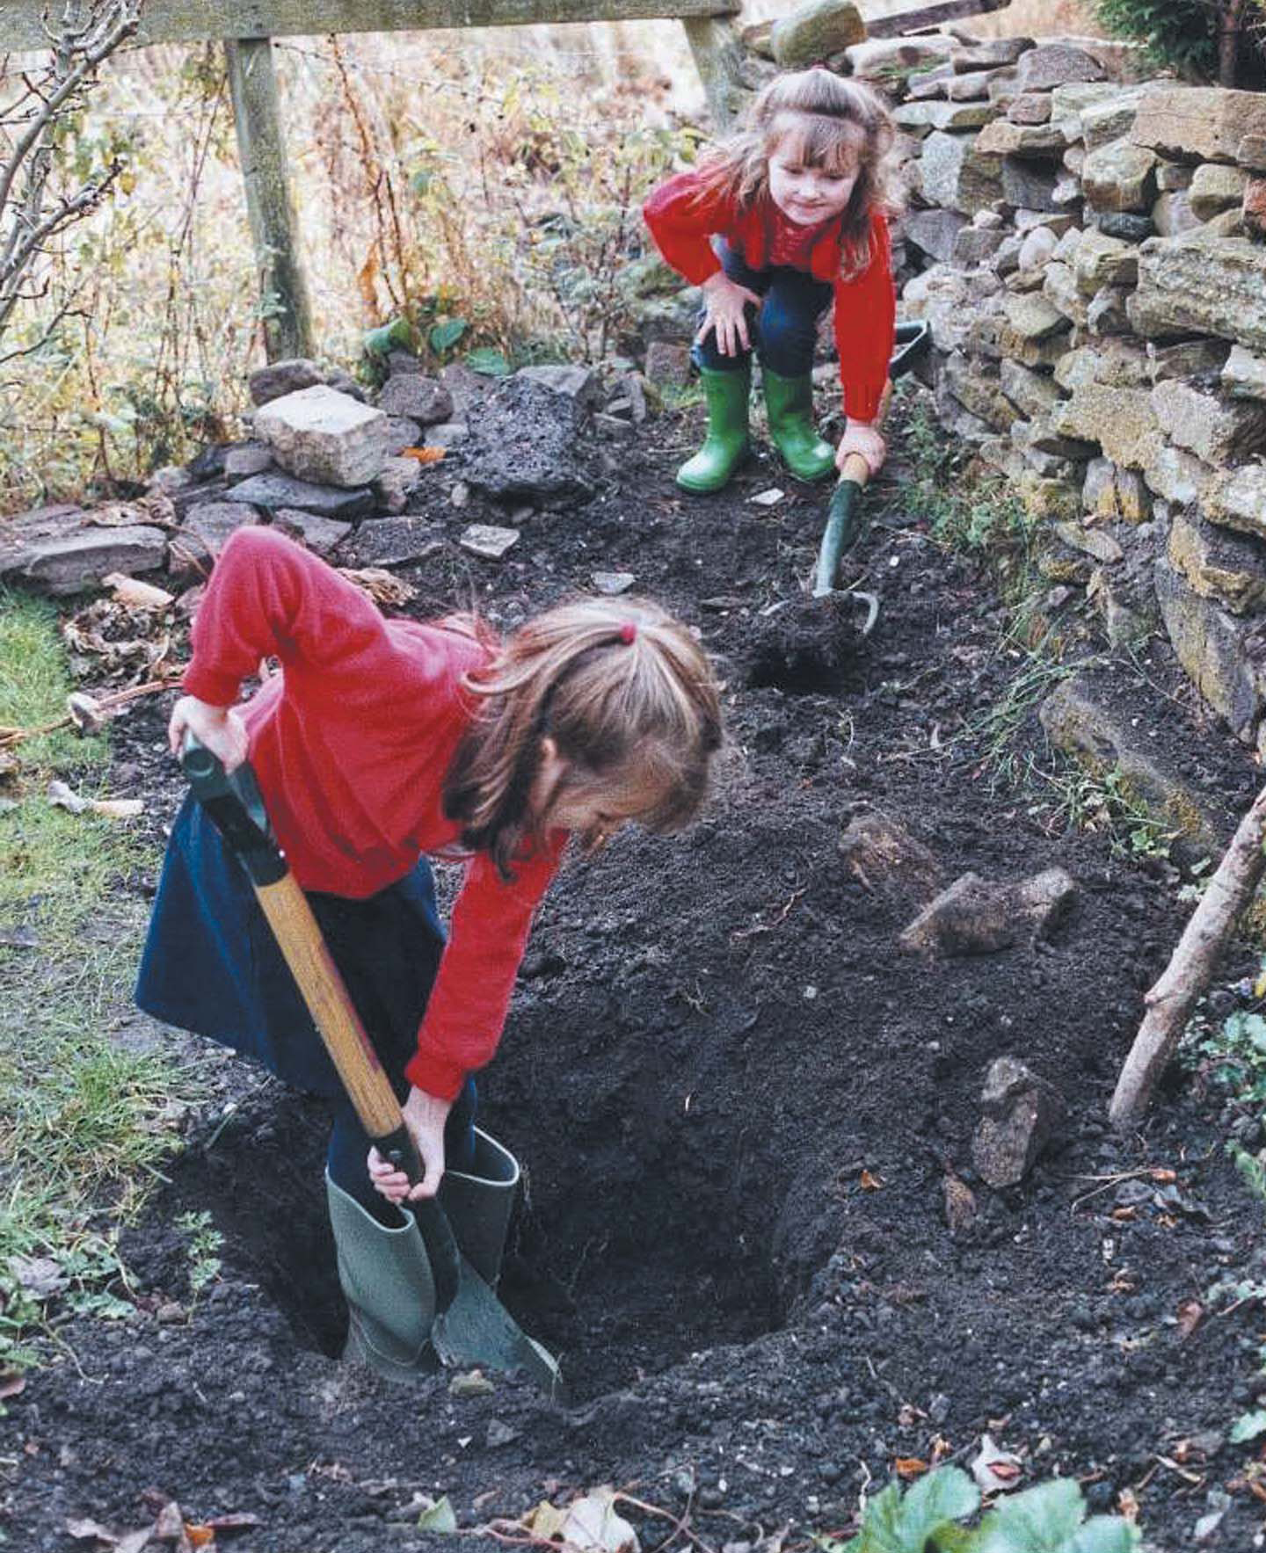
^{Pic 2}
BP Schools Link – Rocks and Fossils
3

Slide 4
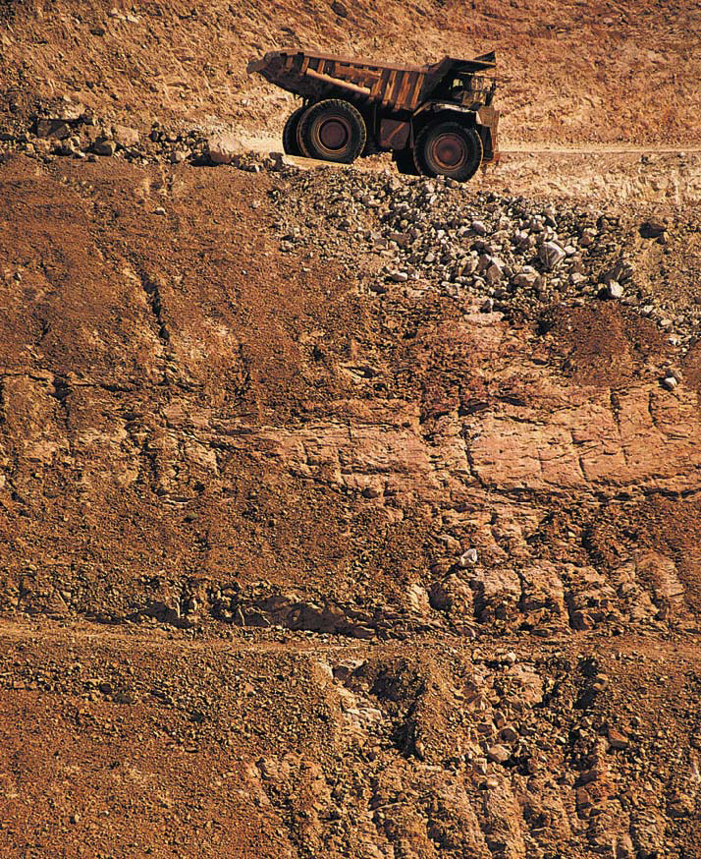
^{Pic 3}
BP Schools Link – Rocks and Fossils
4

Slide 5
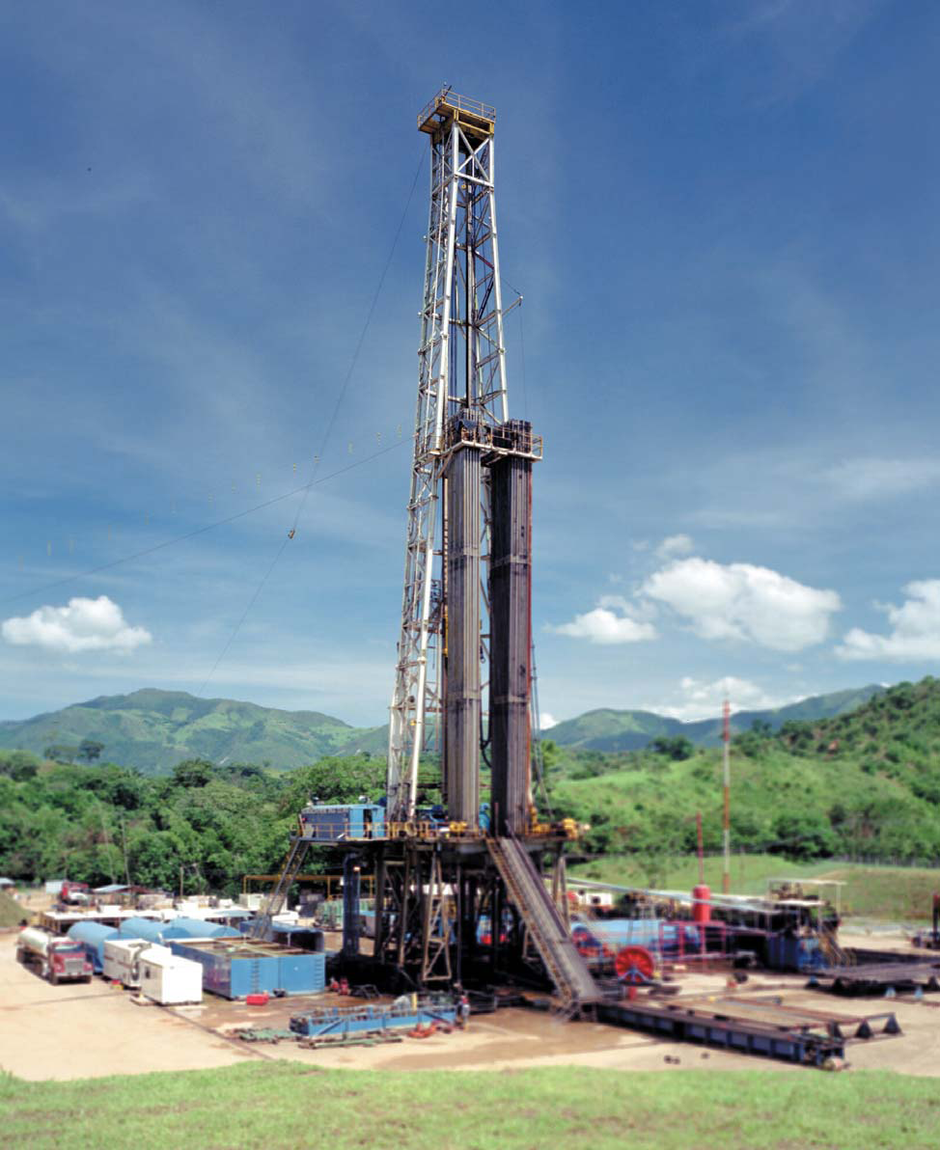
^{Pic 4}
BP Schools Link – Rocks and Fossils
5

Slide 6
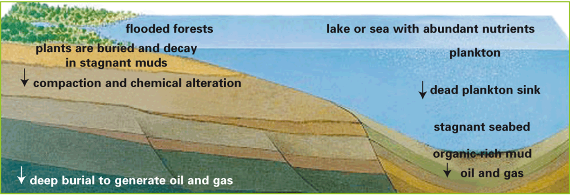
^{The formation of gas} ^{and oil}
BP Schools Link – Rocks and Fossils
6

Slide 7
^{Groups of rocks}
There are three groups of rocks:
Sedimentary
Metamorphic
Igneous
Over millions of years they may change from one into another. This is called ‘The rock cycle’.
BP Schools Link – Rocks and Fossils
7

Slide 8
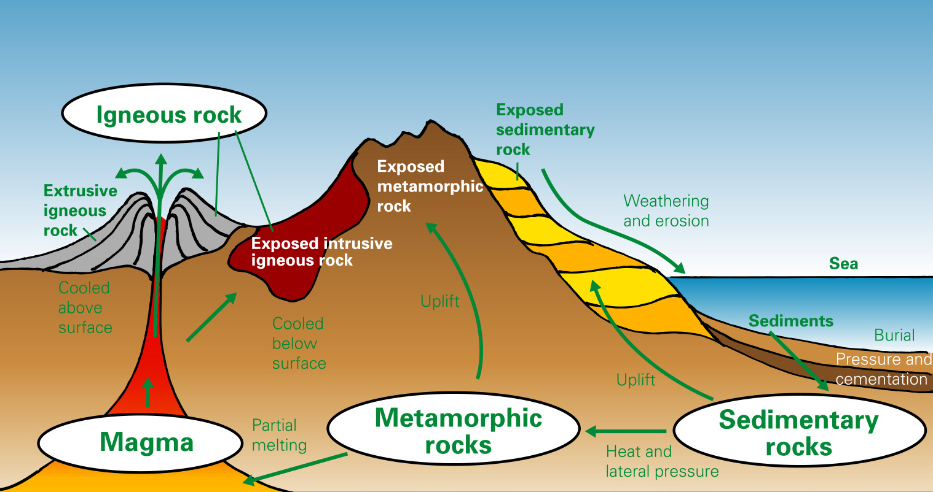
^{The rock cycle}
BP Schools Link – Rocks and Fossils
9

Slide 9
^{Sedimentary rocks 1}
Sedimentary rocks are formed when:
Sediments settle
More layers settle
The pressure squeezes out air and water pockets
Particles are brought closer together
Underground water seeps through,
depositing minerals
These cement the particles into a solid mass
BP Schools Link – Rocks and Fossils
10

Slide 10
^{Sedimentary rocks 2}
Sedimentary rocks are formed in three main ways:
When broken bits of pre-existing rock get laid down (e.g. sandstone)
When salt and other substances are separated by evaporation (e.g. rock salt)
When remains of dead plants and animals build up (e.g. coal)
BP Schools Link – Rocks and Fossils
11

Slide 11
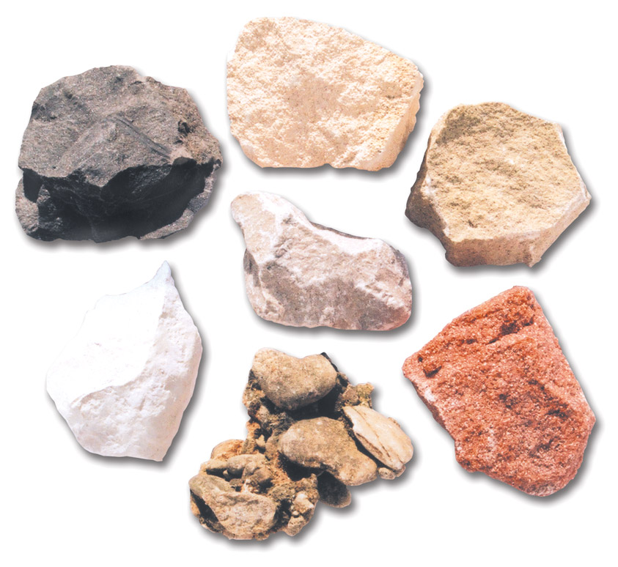
^{Sedimentary rock samples}
Oolitic Limestone
Mudstone
Sandstone
Limestone
Chalk
Desert Sandstone
Conglomerate
BP Schools Link – Rocks and Fossils
12

Slide 12
^{Metamorphic rocks 1}
Metamorphic rocks are formed when:
Heat and/or increased pressure affects existing rocks
These rocks become re-crystallised as a result, but they don’t melt
BP Schools Link – Rocks and Fossils
13

Slide 13
^{Metamorphic rocks 2}
Most metamorphic rocks are formed by:
‘Regional’ processes, deep in the Earth’s crust
‘Thermal’ processes, where great heat from the magma (molten rock) affects the nearby rocks
^{BP Schools Link - Build a Rig}
14

Slide 14
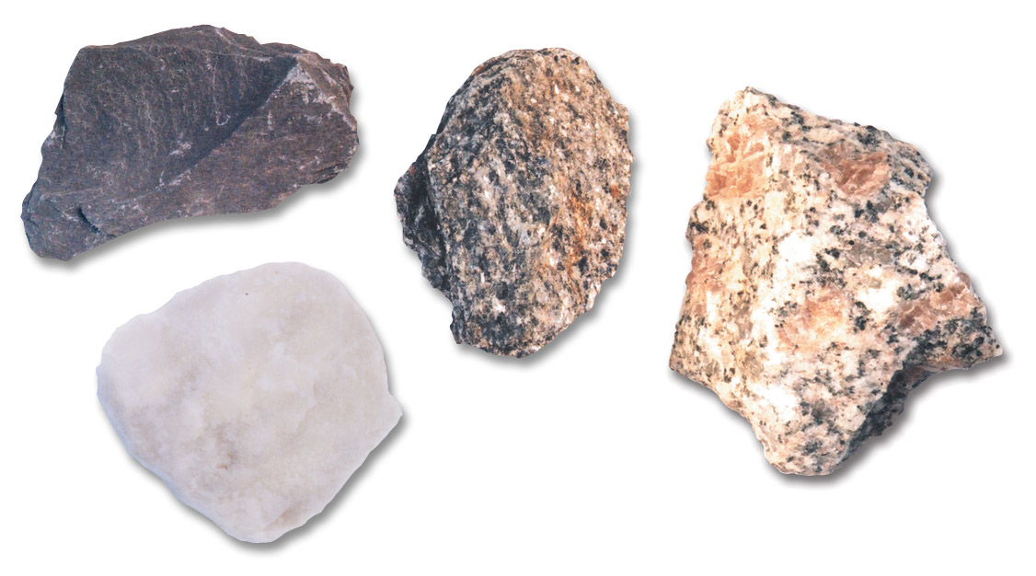
^{Metamorphic rock samples}
Mica Schist
Slate
Banded Gneiss
White Marble
^{BP Schools Link - Build a Rig}
15

Slide 15
^{Igneous rocks 1}
Most igneous rocks are formed when:
Extreme heat partially melts the metamorphic rocks
The molten rock rises and solidifies to form igneous rocks
BP Schools Link – Rocks and Fossils
16

Slide 16
^{Igneous rocks 2}
Igneous rocks are formed in two ways:
Extrusive – when molten rock comes to the surface and cools very quickly
Intrusive – when molten rock cools and solidifies slowly underground
BP Schools Link – Rocks and Fossils
17

Slide 17
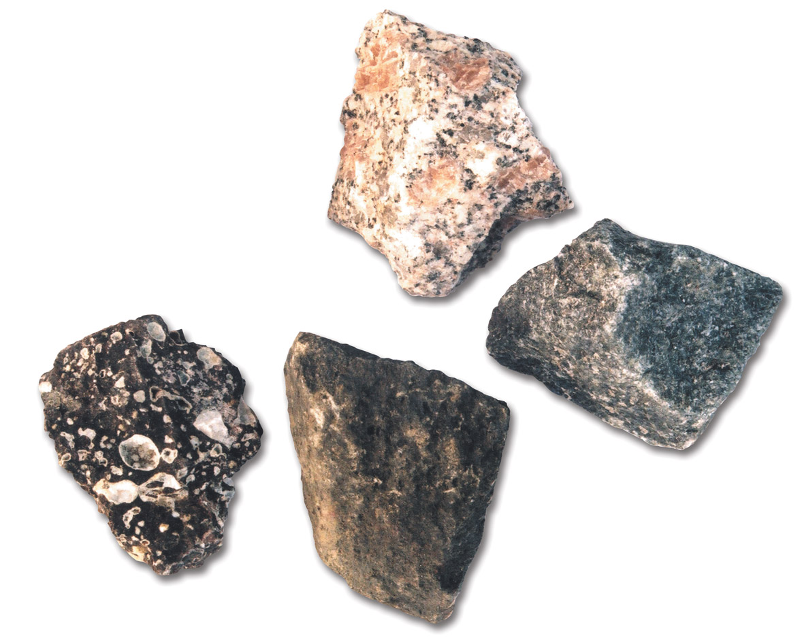
^{Igneous rock samples}
Granite
Amygdaloidal Basalt
(Basalt
with minerals
filling in the
gas holes)
Gabbro
Dolerite
BP Schools Link – Rocks and Fossils
18

Slide 18




^{The life of a fossil 1}
1. Living creature
2. Dead creature sinks to sea floor
3. After months, covered in silt
4. After 1000s of years, under more sand
BP Schools Link – Rocks and Fossils
19

Slide 19
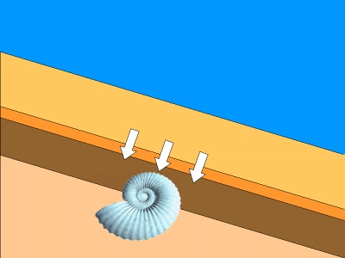

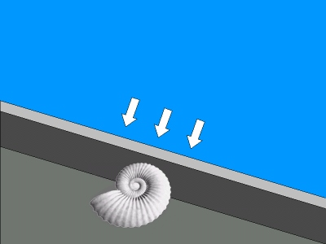
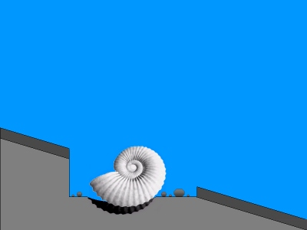
^{The life of a fossil 2}
5. Permineralisation – shell decays
6. After millions of years, shell is replaced
7. Movement in Earth’s plates brings fossil to the surface
8. After 150 million years, fossil is exposed
BP Schools Link – Rocks and Fossils
20

Slide 20
^{What is a fossil?}
Any part of any living thing preserved within a rock
after it has died
It can be:
A footprint
A tooth or single bone
A whole skeleton of an animal, insect or plant
BP Schools Link – Rocks and Fossils
21

Slide 21
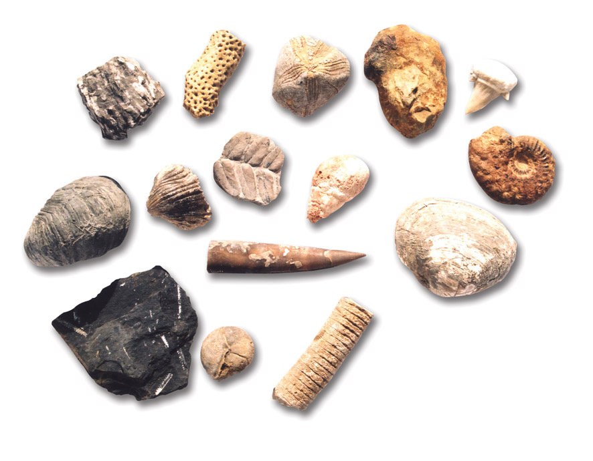
^{Fossil samples}
Fossils come in all shapes and sizes
BP Schools Link – Rocks and Fossils
22

Slide 22
^{Where are fossils found?}
Just like you can press flowers in a flower press, layers of rock preserve plants and animals as fossils
Most fossils are found in sedimentary rock
BP Schools Link – Rocks and Fossils
23

Slide 23
^{How are fossils preserved?}
Hard parts of animals
Soft parts of animals/plants
Traces of animals/plants
The impression of a living thing
Soft parts leave carbon
Drying out
Where no decay has happened
BP Schools Link – Rocks and Fossils
24

Slide 24
^{Fossil fuels 1}
Why do we refer to oil, coal and gas as fossil fuels?
Oil, coal and gas are formed from the remains of dead plants and animals – but they are not really fossils!
They took a long time to form, in the past.
We are using them faster than they can be replaced.
BP Schools Link – Rocks and Fossils
26

Slide 25
^{Fossil fuels 2}
As the remains of plants and animals were buried and trapped, some formed oil and gas:
The rocks acted like a sponge, collecting the oil and gas, storing it in tiny pores
Fossil fuels are mainly found in sedimentary rock
BP Schools Link – Rocks and Fossils
27

