Slide 1
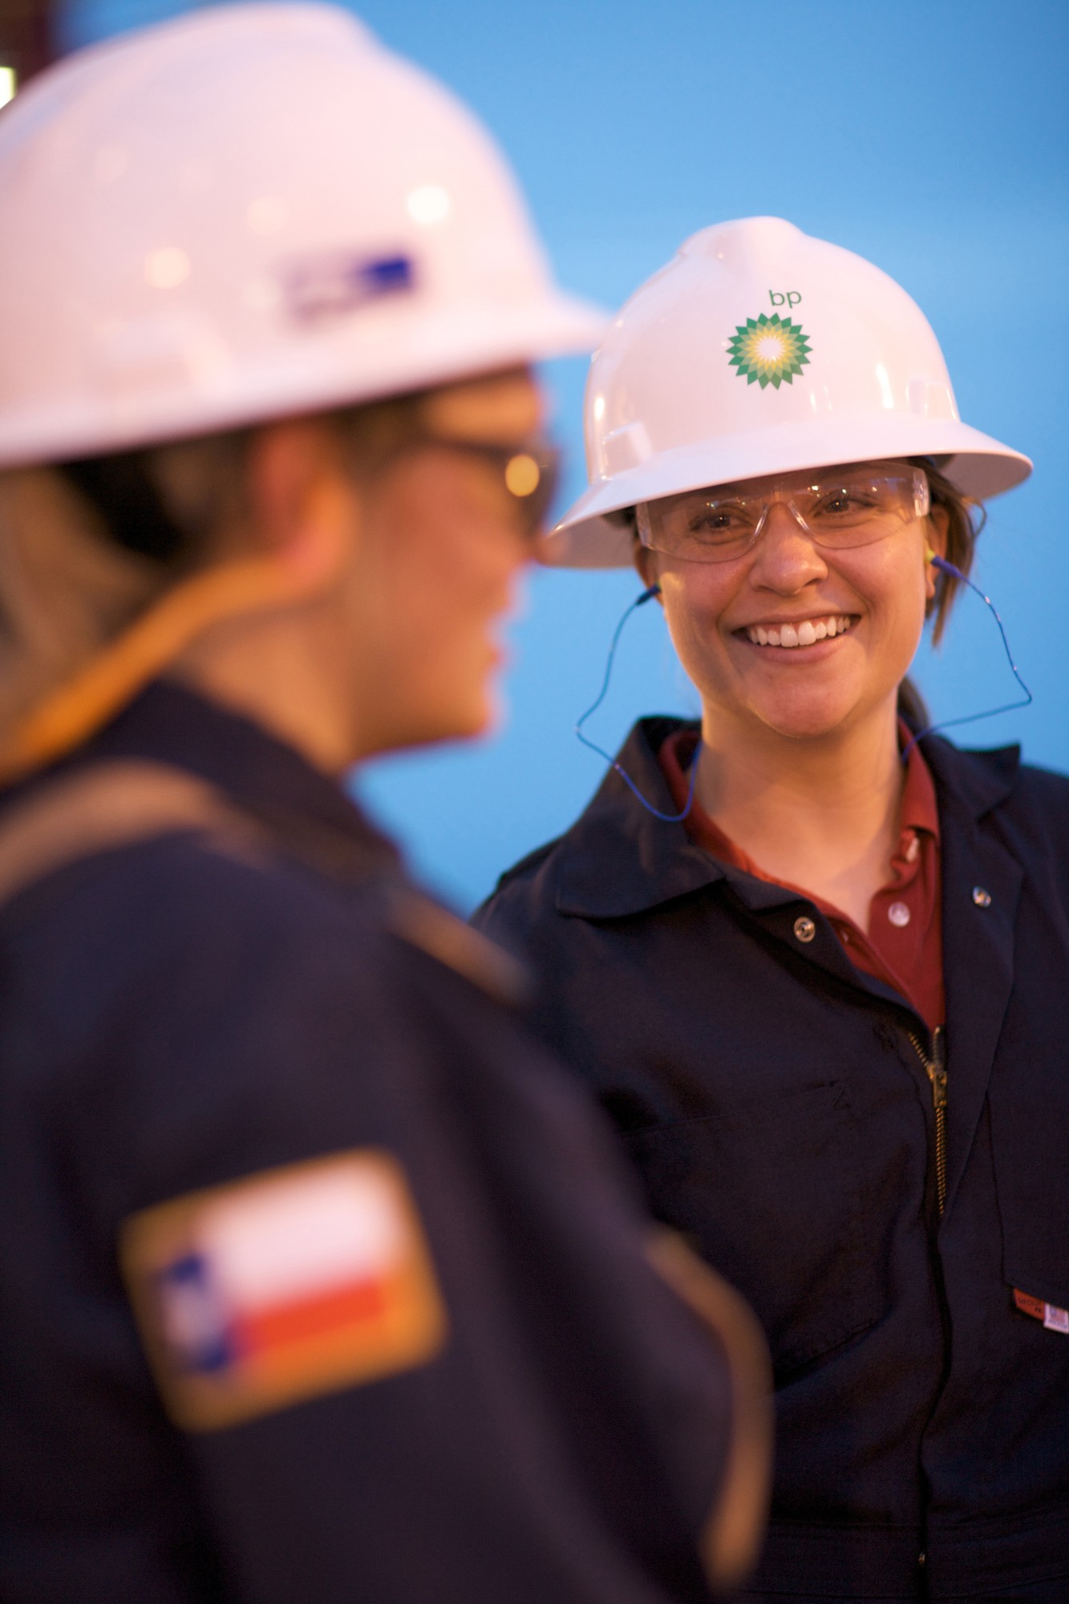
^{Team Building}
^{BP Schools Link}

Slide 2
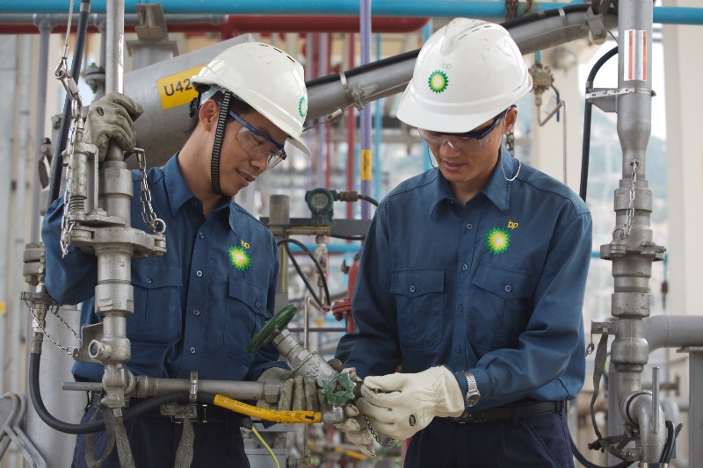
^{What is teamwork?}
It’s . . .
Listening to others
Helping and supporting
Reaching an agreement
Playing your part
BP Schools Link – Team Building
2

Slide 3
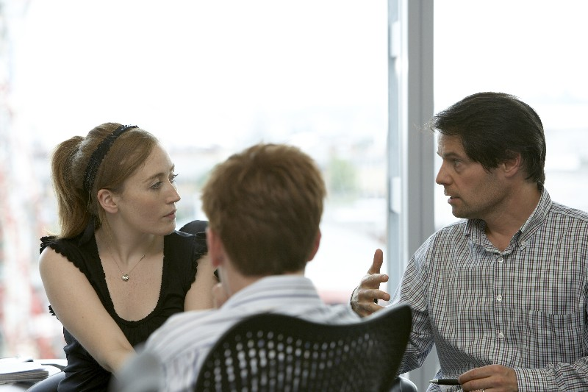
^{What is communication?}
It’s . . .
Listening to others
Allowing each person to speak
Helping others understand you
Checking you understand them
BP Schools Link – Team Building
3

Slide 4
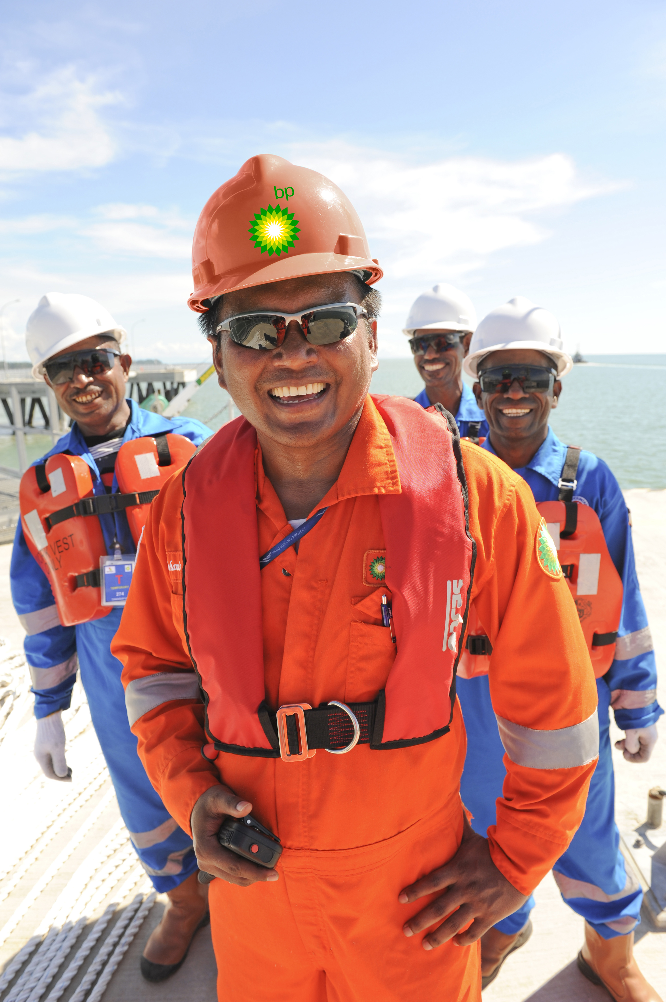
^{Who’s in our team?}
Director
Planning Officer
Store Manager
Research Officer
Construction Manager
Compliance Officer
BP Schools Link – Team Building
4

Slide 5
^{What are the rules?}
Don’t do things that you must not do
Don’t ask the organiser a question once construction starts
Don’t change roles
Don’t change more than one Lego brick
Don’t announce that you’ve finished if your model is not identical
BP Schools Link – Team Building
5

Slide 6
^{How well did you . . .}
Listen to others?
Let other people speak?
Make sure you were understood?
Make sure you understood?
Stick to your role?
Help make decisions?
BP Schools Link – Team Building
6

